Slide 1
Hepatitis B Medications Tenofovir DF (Viread)
Prepared by:
David H. Spach, MD H. Nina Kim, MD
Last Updated: February 21, 2020

Slide 2
Tenofovir DF (TDF) Summary of Key Studies
Phase 3 Trials - Study 102: TDF versus Adefovir in HBeAg-Negative - Study 103: TDF versus Adefovir in HBeAg-Positive - Study 108: TDF versus TAF in HBeAg-Negative - Study 110: TDF versus TAF in HBeAg-Positive

Slide 3
Tenofovir DF versus Adefovir in Chronic HBV *Study 102: HBeAg-Negative
*Published in tandem with Study 103

Slide 4
Tenofovir DF versus Adefovir HBeAg-NEGATIVE Participants: Study 102 Design
102: Study Design
Background: Randomized, double-blind, controlled, phase 3 study to compare tenofovir DF versus adefovir for the treatment of HBeAg-negative adults with chronic HBV Key Inclusion Criteria - Age 18-69 years - HBeAg-negative - ALT 1-10 x ULN - HBV DNA >100,000 copies/mL - CrCl ≥70 mL/min - Knodell necroinflammation score ≥3 - Compensated liver disease
*Tenofovir DF: 300 mg/day
(n = 250)
2x
1x
Adefovir: 10 mg/day
(n = 125)
*Stratified by 1:1 by prior lamivudine or emtricitabine exposure (<12 weeks versus ≥12 weeks)
Source: Marcellin P, et al. N Engl J Med. 2008;359:2442-55.

Slide 5
Tenofovir DF versus Adefovir Study 102: HBeAg-Negative Participants
Baseline Characteristic | Tenofovir DF (n = 250) | Adefovir (n = 125)
Age, mean (±SD), years | 44 ±10.6 | 43 ±10.0
Male, no. (%) | 193 (77) | 97 (78)
Race, no. (%) White Asian Black Other | 161 (64) 63 (25) 8 (3) 18 (7) | 81 (65) 30 (24) 4 (3) 10 (8)
Knodell inflammatory score, mean (±SD) | 7.8 ±2.44 | 7.9 ±2.18
Knodell fibrosis score, mean (±SD) | 2.3 ±1.21 | 2.4 ±1.23
Mean HBV DNA, log₁₀ IU/mL (±SD) | 6.86 ±1.31 | 6.98 ±1.27
Prior treatment with lamivudine or emtricitabine, no. (%) | 43 (17) | 23 (18)
Source: Marcellin P, et al. N Engl J Med. 2008;359:2442-55.

Slide 6
Tenofovir DF versus Adefovir Study 102: HBeAg-Negative
Baseline Characteristic | Tenofovir DF (n = 250) | Adefovir (n = 125)
Alanine aminotransferase, no. (%) <2 x upper limit of normal 2 to <5 x upper limit of normal ≥5 x upper limit of normal | 95 (38) 117 (47) 38 (15) | 38 (30) 54 (43) 33 (26)
Previous treatment with interferon, no. (%) | 42 (17) | 23 (18)
HBV genotype, no. (%) A B C D E, F, G, H Other or unknown | 28 (12) 22 (9) 29 (12) 156 (64) 8 (3) 7 (3) | 14 (11) 17 (14) 12 (10) 79 (63) 3 (2) 0
Source: Marcellin P, et al. N Engl J Med. 2008;359:2442-55.

Slide 7
Tenofovir DF versus Adefovir Study 102: HBeAg-Negative Participants
HBeAg-Negative Participants: Week 48 Treatment Response
P<0.001
P=0.29
*Reduction of ≥2 points in the Knodell necroinflammatory score without an increase in fibrosis
Source: Marcellin P, et al. N Engl J Med. 2008;359:2442-55.

Slide 8
Safety and Adverse Events Study 102 (HBeAg-Negative) & 103 (HBeAg-Positive)
Conclusions: “Among patients with chronic HBV infection, tenofovir DF at a daily dose of 300 mg had superior antiviral efficacy with a similar safety profile as compared with adefovir dipivoxil at a daily dose of 10 mg through week 48.”
Source: Marcellin P, et al. N Engl J Med. 2008;359:2442-55.

Slide 9
Tenofovir DF versus Adefovir in Chronic HBV Study 103: HBeAg-Positive
Tenofovir DF versus Adefovir in Chronic HBV
*Published in tandem with Study 102

Slide 10
Tenofovir DF versus Adefovir HBeAg-POSITIVE Participants: Study 103 Design
103: Study Design
Background: Randomized, double-blind, controlled, phase 3 study to compare tenofovir DF versus adefovir for the treatment of HBeAg-positive adults with chronic HBV Key Inclusion Criteria - Age 18-69 years - HBeAg-positive (≥6 months) - ALT 2-10 x upper limit of normal - HBV DNA >1 million copies/mL - CrCl ≥70 mL/min - Knodell necroinflammation score ≥3 - Compensated liver disease
*Tenofovir DF: 300 mg/day
(n = 176)
2x
1x
Adefovir: 10 mg/day
(n = 90)
*Stratified by 1:1 by ALT elevation
(<4X ULN versus ≥4X ULN)
Source: Marcellin P, et al. N Engl J Med. 2008;359:2442-55.

Slide 11
Tenofovir DF versus Adefovir Study 103: HBeAg-Positive
Baseline Characteristic | Tenofovir DF (n = 176) | Adefovir (n = 90)
Age, mean (±SD), years | 34 ±11 | 34 ±12
Male, no. (%) | 119 (68) | 64 (71)
Race, no. (%) White Asian Black Other | 92 (52) 64 (36) 13 (7) 7 (4) | 46 (51) 32 (36) 5 (6) 7 (8)
Knodell inflammatory score, mean (±SD) | 8.3 ±2.14 | 8.3 ±2.27
Knodell fibrosis score, mean (±SD) | 2.3 ±1.23 | 2.4 ±1.19
Mean HBV DNA, log₁₀ IU/mL (±SD) | 8.64 ±1.076 | 8.88 ±0.930
Prior treatment with lamivudine or emtricitabine, no. (%) | 8 (5) | 1 (1)
Source: Marcellin P, et al. N Engl J Med. 2008;359:2442-55.

Slide 12
Tenofovir DF versus Adefovir Study 103: HBeAg-Positive
Baseline Characteristic | Tenofovir (n = 176) | Adefovir (n = 90)
Alanine aminotransferase, no. (%) <2 x upper limit of normal 2 to <5 x upper limit of normal ≥5 x upper limit of normal | 39 (22) 105 (60) 32 (18) | 16 (18) 55 (61) 19 (21)
Previous treatment with interferon, no. (%) | 30 (17) | 13 (14)
HBV genotype, no. (%) A B C D E, F, G, H Other or unknown | 41 (24) 25 (14) 43 (25) 55 (32) 9 (5) 3 (2) | 18 (20) 10 (11) 26 (30) 31 (35) 3 (3) 2 (2)
Source: Marcellin P, et al. N Engl J Med. 2008;359:2442-55.

Slide 13
Tenofovir DF versus Adefovir Study 103: HBeAg-Positive Results
HBeAg-Positive Participants: Week 48 Treatment Response
P<0.001
P=0.32
*Reduction of ≥2 points in the Knodell necroinflammatory score without an increase in fibrosis
Source: Marcellin P, et al. N Engl J Med. 2008;359:2442-55.

Slide 14
Tenofovir DF versus Adefovir Study 103 Serologic Responses
HBeAg-Positive Participants: Week 48 Treatment Response
P=0.36
P=0.02
Source: Marcellin P, et al. N Engl J Med. 2008;359:2442-55.

Slide 15
Safety and Adverse Events Study 102 (HBeAg-Negative) & 103 (HBeAg-Positive)
Conclusions: “Among patients with chronic HBV infection, tenofovir DF at a daily dose of 300 mg had superior antiviral efficacy with a similar safety profile as compared with adefovir dipivoxil at a daily dose of 10 mg through week 48.”
Source: Source: Marcellin P, et al. N Engl J Med. 2008;359:2442-55.

Slide 16
Tenofovir DF versus Adefovir in Chronic HBV Study 102 and 103: Combined Data Analysis
*Published in tandem with Study 102

Slide 17
Tenofovir DF versus Adefovir Study Design: 102 and 103
Background - Two phase 3, randomized double-blind controlled trials - 106 center sites: Europe (60), Asian-Pacific (15), N. America (31)
Subjects - Study 102: Chronic HBeAg-negative with ALT >1 and <10x ULN - Study 103: Chronic HBeAg-positive with ALT >2 and <10x ULN - Exclusions: decompensated liver disease; HIV, HCV, or delta infection; HCC; CrCl <70 mL/min, Hgb <8 mg/dL, or ANC <1,000/mm³
End-Points - Primary: HBV DNA to <400 copies/mL & histologic improvement (≥2 point drop in Knodell score without increased fibrosis) - Secondary: HBV DNA and ALT levels over time, HBeAg and HBsAg loss and seroconversion
Source: Marcellin P, et al. N Engl J Med. 2008;359:2442-55.

Slide 18
Tenofovir DF versus Adefovir Study 102 and 103: 48 Week Treatment Response
Study 102: HBeAg-Negative Patients
Study 103: HBeAg-Positive Patients
P<0.001
P=0.32
P<0.001
P=0.29
*Reduction of ≥2 points in the Knodell necroinflammatory score without an increase in fibrosis
Source: Marcellin P, et al. N Engl J Med. 2008;359:2442-55.

Slide 19
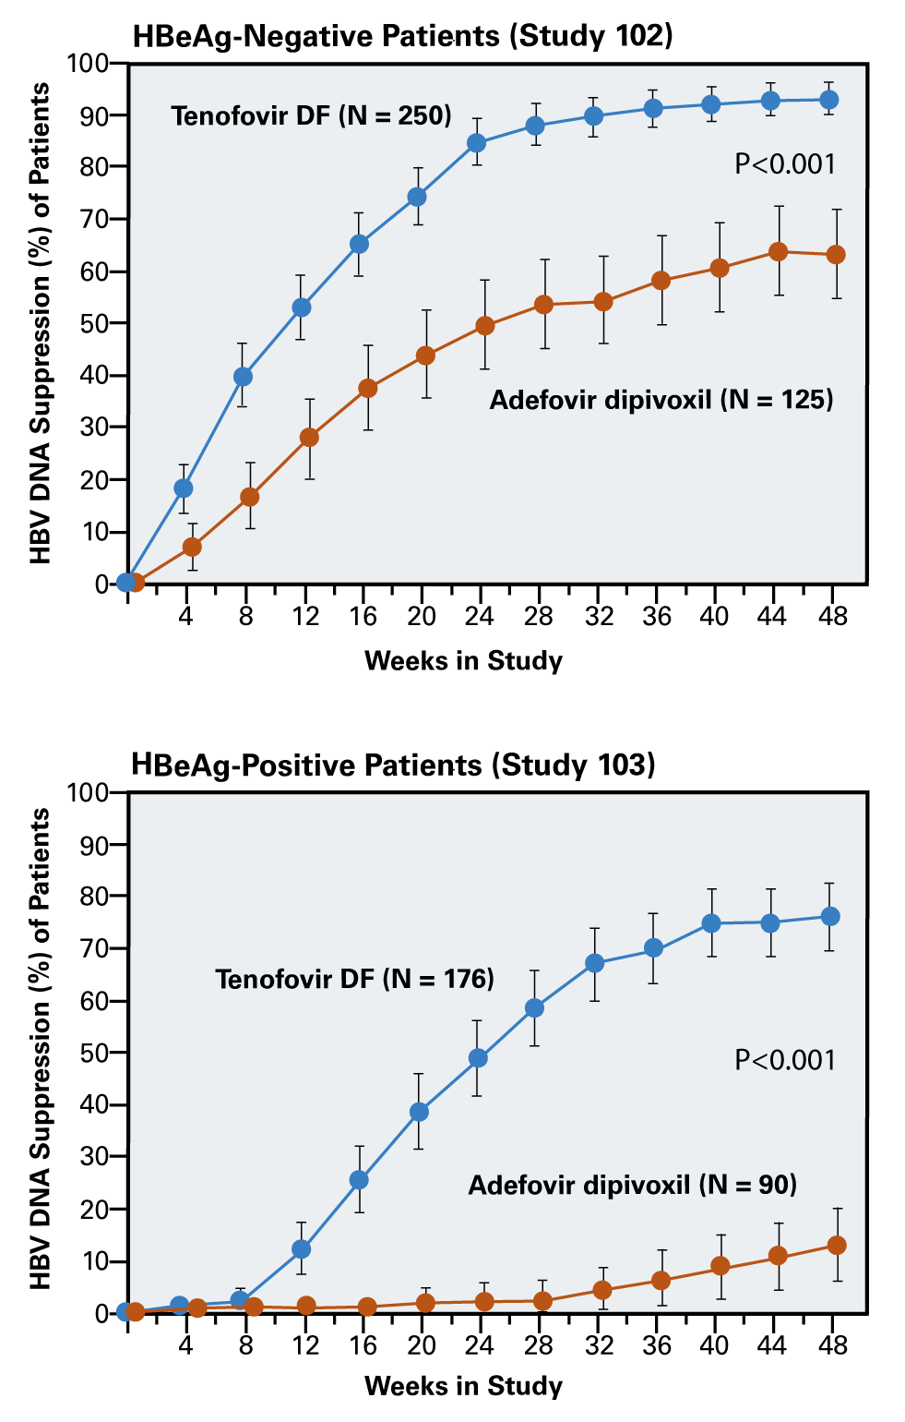
Tenofovir DF in Patients with Chronic HBV Study 102 and 103: 48 Week Treatment Response
Study 102: HBeAg-Negative Patients
Study 103: HBeAg-Positive Patients
*HBV DNA suppression defined as <400 copies/mL
Source: Marcellin P, et al. N Engl J Med. 2008;359:2442-55.

Slide 20
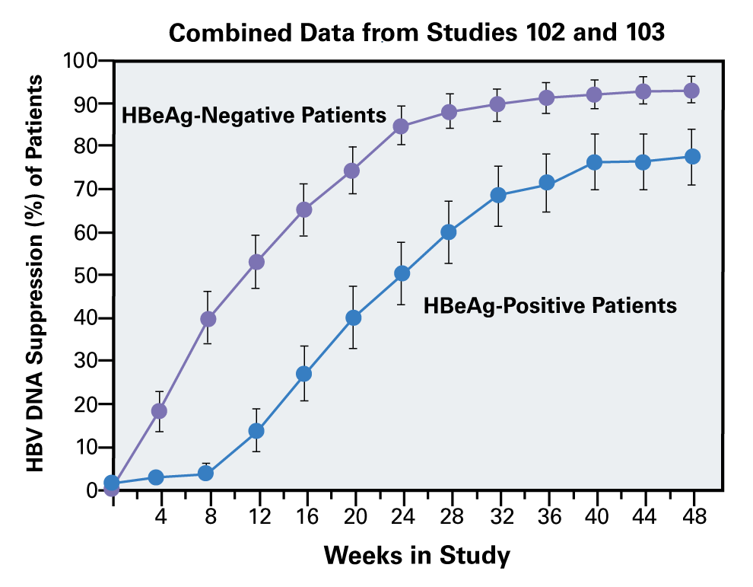
Tenofovir DF in Patients with Chronic HBV Combined Data from Studies 102 and 103
*HBV DNA suppression defined as <400 copies/mL
Source: Marcellin P, et al. N Engl J Med. 2008;359:2442-55.

Slide 21
Safety and Adverse Events Study 102 and 103: HBeAg-Negative and HBeAg-Positive
Baseline Characteristic | Tenofovir DF (n = 426) | Adefovir (n = 215)
Any adverse event ≥10%, no. (%) Headache Nasopharyngitis Nausea | 39 (22) 105 (60) 32 (18) | 16 (18) 55 (61) 19 (21)
Serious adverse event, no. (%) | 27 (6) | 14 (7)
Adverse event leading to discontinuation, no. (%) | 5 (1) | 3 (1)
Lab abnormalities, no. (%) Grade 3 ALT (>5-10x ULN) and 2x baseline Grade 4 ALT (>10x ULN) and 2x baseline Confirmed serum Cr increase ≥0.5 mg/dL Confirmed creatinine clearance <50 mL/min | 13 (3) 11 (3) 0 0 | 2 (1) 4 (2) 1 (<1) 0
UNL = upper limit of normal
Source: Marcellin P, et al. N Engl J Med. 2008;359:2442-55.

Slide 22
Safety and Adverse Events Study 102 (HBeAg-Negative) & 103 (HBeAg-Positive)
Conclusions: “Among patients with chronic HBV infection, tenofovir DF at a daily dose of 300 mg had superior antiviral efficacy with a similar safety profile as compared with adefovir dipivoxil at a daily dose of 10 mg through week 48.”
Source: Source: Marcellin P, et al. N Engl J Med. 2008;359:2442-55.

Slide 23
Impact of Tenofovir DF on Fibrosis and Cirrhosis Studies 102 and 103: 5-Year Follow-Up

Slide 24
Impact of Tenofovir DF on Fibrosis and Cirrhosis Study 102 and 103: 5-Year Follow-Up Design
Background - Open-label, single-arm continuation study of the 48-week phase 3 randomized controlled trials (Study 102, 103) of tenofovir DF vs adefovir
Subjects - N = 348 with chronic HBeAg-negative or HBeAg-positive - All switched to open-label tenofovir DF after blinded phase complete - Had liver biopsies at baseline (year 1) and year 5 of follow-up.
Regimen - Tenofovir DF 300 mg once daily
Study End-Points - Histologic Response: ≥2-point decrease in the Knodell necroinflammatory score and no worsening in Knodell fibrosis score. - Fibrosis regression: ≥1-point decrease in Ishak fibrosis score
Source: Marcellin et. al. Lancet. 2013;381:468-75.

Slide 25
Impact of Tenofovir DF on Fibrosis and Cirrhosis Study Design
Randomized Trial
Open-Label Phase
Completed Trial
n = 641
n = 585
n = 489
Biopsy
Biopsy
Biopsy
n = 348
48 weeks
Year 5
Tenofovir DF 300 mg/day
Tenofovir DF 300 mg/day
Adefovir 10 mg/day
Source: Marcellin et. al. Lancet. 2013;381:468-75.

Slide 26
Impact of Tenofovir DF on Fibrosis and Cirrhosis Characteristics of Participants with Baseline Cirrhosis
Baseline Characteristics of Participants with Cirrhosis at Baseline | No Cirrhosis at Year 5 n = 71 | Cirrhosis at Year 5 n = 25 | P-value
Age >40 years, n (%) | 49 (69) | 20 (80) | 0.44
Male sex, n (%) | 58 (92) | 22 (88) | 0.55
Asian origin, n (%) | 19 (27) | 3 (12) | 0.17
BMI, mean kg/m² (SD) | 25.7 (3.7) | 29.0 (4.4) | 0.007
Knodell necroinflammatory score, mean (SD) | 8.8 (1.6) | 9.0 (1.7) | 0.69
HBV DNA level, mean log₁₀ copies/ml (SD) | 7.4 (1.5) | 7.5 (1.2) | 0.63
Ishak fibrosis stage, n (%) 5 6 | 17 (24) 54 (76) | 2 (8) 23 (92) | 0.14
Prior treatment, n (%) Interferon Lamivudine use >12 weeks | 16 (22) 16 (22) | 3 (12) 2 (8) | 0.38 0.14
Diabetes, n (%) | 1 (1) | 6 (24) | 0.001
Source: Marcellin et. al. Lancet. 2013;381:468-75.

Slide 27
Impact of Tenofovir DF on Fibrosis and Cirrhosis Characteristics of Participants with Baseline Cirrhosis
On-Treatment Characteristics of Participants with Baseline Cirrhosis | No Cirrhosis at Year 5 n = 71 | Cirrhosis at Year 5 n = 25 | P-value
HBV DNA <400 copies/mL, n/N (%) | 69/69 (100) | 24/24 (100)
Normal ALT, n/N (%) | 59/68 (87) | 14/24 (58) | 0.007
HBeAg loss, n/N (%) | 12/23 (52) | 6/7 (86) | 0.193
Change from baseline to week 12 in HBsAg (10⁶ IU/L), mean (SD) | -4.8 (19.7) | -0.22 (7.7) | 0.804
Change from baseline Knodell score, mean (SD) | -5.6 (2.2) | -4.6 (2.4) | 0.053
Knodell score at year 5, n (%) 0-3 4-6 7-9 | 59 (83) 7 (10) 5 (7) | 13 (52) 7 (28) 5 (20) | 0.007
HBsAg loss, n/N (%) | 1/69 (1) | 0/24 (0) | 1.000
Source: Marcellin et. al. Lancet. 2013;381:468-75.

Slide 28
Impact of Tenofovir DF on Fibrosis and Cirrhosis Histologic Improvement at Year 5 (All participants)
136/348
304/348
115/126
Source: Marcellin et. al. Lancet. 2013;381:468-75.

Slide 29
Impact of Tenofovir DF on Fibrosis and Cirrhosis Changes in Knodell and Ishak Scores Among All Participants
Source: Marcellin et. al. Lancet. 2013;381:468-75.

Slide 30
Impact of Tenofovir DF on Fibrosis and Cirrhosis Conclusions
Conclusions: “In patients with chronic HBV infection, up to 5 years of treatment with tenofovir DF was safe and effective. Long-term suppression of HBV can lead to regression of fibrosis and cirrhosis.”
Source: Marcellin et. al. Lancet. 2013;381:468-75.

Slide 31
Tenofovir AF vs Tenofovir DF in HBeAg-Negative Study 108

Slide 32
Tenofovir AF vs Tenofovir DF for HBeAg-Negative Study 108: Design
Background - Randomized double-blind placebo-controlled non-inferiority trial of tenofovir alafenamide (TAF) versus tenofovir disoproxil fumarate (TDF) in HBeAg-negative adults with chronic hepatitis B
Subjects (n = 426) - Age ≥18 years - Chronic HBeAg-negative - HBV DNA level >20,000 IU/mL - ALT >60 IU/L in men, >38 IU/L in women; ALT <10 x ULN for both
Regimen - Tenofovir AF: 25 mg once daily with matching placebo - Tenofovir DF: 300 mg once daily with matching placebo
Study End-Point - HBV DNA level <29 IU/mL at week 48
Source: Buti M, et. al. Lancet Gastroenterol Hepatol. 2016;1:196-206.

Slide 33
Tenofovir AF vs Tenofovir DF for HBeAg-Negative Study 108: Design
Time 0
Week 48
Week 96
Analysis
Analysis
Study Participants
HBeAg-negative HBV DNA level >20,000 IU/mL ALT >60 IU/L for men ALL >38 IU/L for women CrCl >50 mL/min
Tenofovir alafenamide: 25 mg/day
(n = 285)
2x
1x
Tenofovir DF: 300 mg/day
(n = 140)
Source: Buti M, et. al. Lancet Gastroenterol Hepatol. 2016;1:196-206.

Slide 34
Tenofovir AF vs Tenofovir DF for HBeAg-Negative Study 108: Baseline Characteristics
Baseline Characteristic | Tenofovir AF (n = 285) | Tenofovir DF (n = 140)
Age, mean (±SD), years | 45 (12) | 48 (10)
Male, no. (%) | 173 (61) | 86 (61)
Race, no. (%) Asian White Black Other | 205 (72) 71 (25) 5 (2) 4 (2) | 101 (72) 35 (25) 3 (2) 1 (1)
ALT > ULN by central lab, no. (%) | 236 (83) | 121 (86)
HBV DNA, log₁₀ IU/mL (±SD) | 5.7 (1.3) | 5.8 (1.3)
FibroTest score ≥0.75, no. (%) | 31/280 (11) | 20/139 (14)
Previous nucleos(t)ide therapy, no. (%) | 60 (21) | 31 (22)
Previous interferon therapy, no. (%) | 29 (10) | 19 (14)
Source: Buti M, et. al. Lancet Gastroenterol Hepatol. 2016;1:196-206.

Slide 35
Tenofovir AF vs Tenofovir DF for HBeAg-Negative Study 108: Results at Week 48
P=0.47
P=0.076
P=0.0005
*Using normal ranges of ≤30 U/L for men and ≤19 U/L for women
Source: Buti M, et. al. Lancet Gastroenterol Hepatol. 2016;1:196-206.

Slide 36
Tenofovir AF vs Tenofovir DF for HBeAg-Negative Study 108: Adverse Effects
Week 48 Changes in Bone Mineral Density (BMD)
Source: Buti M, et. al. Lancet Gastroenterol Hepatol. 2016;1:196-206.

Slide 37
Tenofovir AF vs Tenofovir DF for HBeAg-Negative Study 108: Adverse Effects
Week 48 Changes in Bone Mineral Density (BMD)
Source: Buti M, et. al. Lancet Gastroenterol Hepatol. 2016;1:196-206.

Slide 38
Tenofovir AF vs Tenofovir DF for HBeAg-Negative Study 108: Results
Interpretation: “In patients with HBeAg-negative chronic HBV, the efficacy of tenofovir alafenamide was non-inferior to that of tenofovir disoproxil fumarate, and had improved bone and renal effects. Longer term follow-up is needed to better understand the clinical impact of these changes.”
Source: Buti M, et. al. Lancet Gastroenterol Hepatol. 2016;1:196-206.

Slide 39
Tenofovir AF vs Tenofovir DF in HBeAg-Positive Study 110

Slide 40
Tenofovir AF vs Tenofovir DF for HBeAg-Positive Study 110: Design
Background - Randomized double-blind placebo-controlled non-inferiority trial of tenofovir alafenamide (TAF) versus tenofovir disoproxil fumarate (TDF) in HBeAg-positive chronic hepatitis B patients
Subjects - N = 1473 with chronic hepatitis B eAg-positive infection - HBV DNA level >20,000 IU/mL - ALT >60 IU/L in men, >38 IU/L in women; <10 x ULN for both
Regimens - Tenofovir AF 25 mg once daily with matching placebo - Tenofovir DF 300 mg once daily with matching placebo
Study End-Point - HBV DNA level <29 IU/mL at week 48
Source: Chan HL, et. al. Lancet Gastroenterol Hepatol. 2016;1:185-95.

Slide 41
Tenofovir AF vs Tenofovir DF for HBeAg-Positive Study 110: Design
Time 0
Week 48
Week 96
Randomized 2:1
Analysis
Analysis
Study Participants
HBeAg-positive HBV DNA level >20,000 IU/mL ALT >60 IU/L for men ALT >38 IU/L for women CrCl>50 ml/min
Tenofovir alafenamide: 25 mg/day
(n = 581)
Tenofovir DF: 300 mg/day
(n = 292)
Source: Chan HL, et. al. Lancet Gastroenterol Hepatol. 2016;1:185-95.

Slide 42
Tenofovir AF vs Tenofovir DF for HBeAg-Positive Study 110: Baseline Characteristics
Baseline Characteristic | Tenofovir AF (n = 581) | Tenofovir DF (n = 292)
Age, mean (±SD), years | 38 (11) | 38 (12)
Male, no. (%) | 371 (64) | 189 (65)
Race, no. (%) Asian White Other | 482 (83) 96 (17) 3 (1) | 232 (79) 53 (18) 7 (2)
ALT > ULN by central lab, no. (%) | 537 (98) | 288 (99)
HBV DNA, log₁₀ IU/mL (±SD) | 7.6 (1.3) | 7.6 (1.4)
FibroTest score, mean (±SD) | 0.34 (0.23) | 0.32 (0.22)
Cirrhosis, no. (%) | 41 (7) | 24 (8)
Serum creatinine, mean (±SD) | 0.81 (0.17) | 0.82 (0.16)
Source: Chan HL, et. al. Lancet Gastroenterol Hepatol. 2016;1:185-95.

Slide 43
Tenofovir AF vs Tenofovir DF for HBeAg-Positive Study 110: Results at Week 48
P=0.25
P=0.014
P=0.47
*Using normal ranges of ≤30 U/L for men and ≤19 U/L for women
Source: Chan HL, et. al. Lancet Gastroenterol Hepatol. 2016;1:185-95.

Slide 44
Tenofovir AF vs Tenofovir DF for HBeAg-Positive Study 110: Adverse Effects
Week 48 Changes in Bone Mineral Density (BMD)
Source: Chan HL, et. al. Lancet Gastroenterol Hepatol. 2016;1:185-95.

Slide 45
Tenofovir AF vs Tenofovir DF for HBeAg-Positive Study 110: Conclusion
Interpretation: “In patients with HBeAg-positive HBV infection, tenofovir alafenamide was non-inferior to tenofovir disoproxil fumarate, and had improved bone and renal effects. Longer term follow-up is needed to better understand the clinical impact of these changes.”
Source: Buti M, et. al. Lancet Gastroenterol Hepatol. 2016;1:196-206.

