Slide 1
Hepatitis B Interpreting Hepatitis B Serologies
Prepared by:
H. Nina Kim, MD, MSc
Last Updated: October 5, 2022
Notes:
Hello! I’m Dr. Nina Kim from the University of Washington. Interpreting hepatitis B serologies can be challenging for some clinicians. Hopefully after this session, you will have an easier time making sense of the different serologic profiles.

Slide 2
Disclosures
H. Nina Kim, MD MSc
Gilead Sciences provides program funding to my institution

Slide 3
Hepatitis B (HBV) Serologies
Virology – key structures
Acute HBV infection
Chronic HBV infection
Hep B serologic profiles
Notes:
In this talk, I will review the key structures of the virus, including the targets of serologic testing.
We will also look at the evolution of these serum markers over the course of acute infection that goes on to resolution and clearance of virus…
and how these markers evolve in an individual who remains chronically infected.
Understanding these targets and this evolution will go a long way in helping you understand and interpret the different serologic profiles related to hepatitis B.

Slide 4
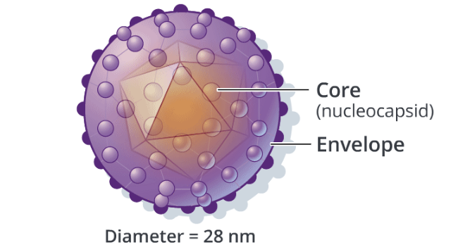
Hepatitis B Virus: Key Structures
Image Credit: Cognition Studios, Inc.
Notes:
In the next set of slides, I have simplified the viral structure to highlight the key targets of serologic testing.
Hepatitis B is a partially double-stranded DNA virus - two key structures are the nucleocapsid core that is encased by the envelope.

Slide 5
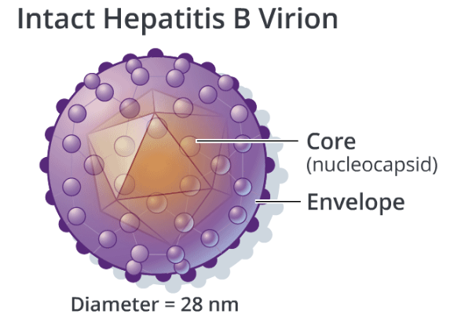
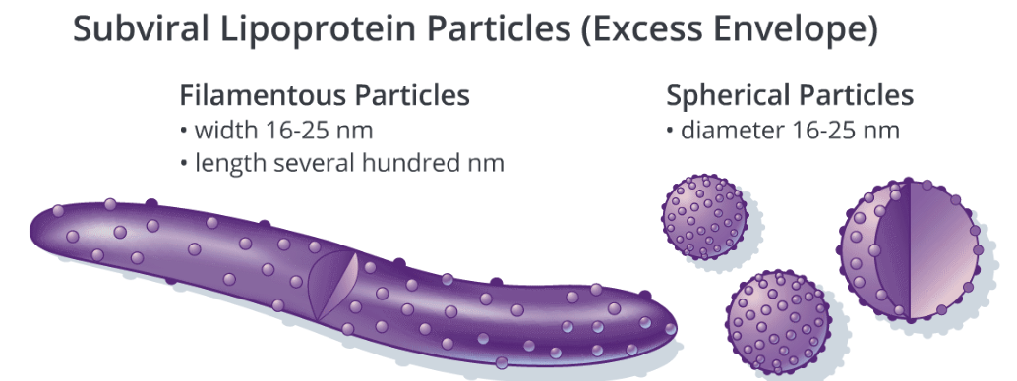
Hepatitis B Virus: Surface Antigen
Hepatitis B surface Ag
Image Credit: Cognition Studios, Inc.
Notes:
HB surface antigen is our first serologic marker. It is a lipoprotein and component of the envelope and the major site for binding of neutralizing antibody. It is ALSO the primary serologic marker of active infection – whether acute or chronic. HBsAg can circulate as part of virion or independently as viral particles. Either way, it can be measured directly in the blood.

Slide 6
Hepatitis B Virus: E antigen and Core antigen
Image Credit: Cognition Studios, Inc.
Notes:
In addition to the surface antigen, the virus produces 2 nucleocapsid proteins: HBeAg and core Ag. *NEXT SLIDE*

Slide 7
Hepatitis B Virus: E antigen and Core antigen
Image Credit: Cognition Studios, Inc.
Notes:
Hep B e antigen is secreted into the circulation while the hep B core antigen is assembled to form the viral core which is then later packaged as part of the intact hep B virion.
For this reason… We are able to measure e antigen directly in blood but unable to measure core Ag.

Slide 8
Hepatitis B Virus: Antibodies
Image Credit: Cognition Studios, Inc.
Notes:
So an individual who is exposed to the virus generally makes 3 types of antibodies in response to infection.
Anti-HBs (surface antibody) binds to the surface antigen in its various forms. This is our main marker of hepatitis B seroprotection.
There is also antibody to e Ag and core Ag.
In contrast to surface antibody, these antibodies do not confer lasting immunity. They basically indicate that this person has been exposed to the virus.
We will not be talking further re E antibody since this test is not used in diagnosis but typically reserved for those who have chronic infection.

Slide 9
Hepatitis B Virus: Standard Serologic Panel
Surface Antigen (HBsAg)
Surface Antibody (anti-HBs)
Core Antibody, total (anti-HBc)
Notes:
For the purpose of this talk we will be focusing on 3 main serologic markers: surface antigen, surface antibody and core antibody – These comprise a standard hepatitis B panel.
This is really all you need to sort out isomeone’s immune status and history of exposure to the virus.

Slide 10
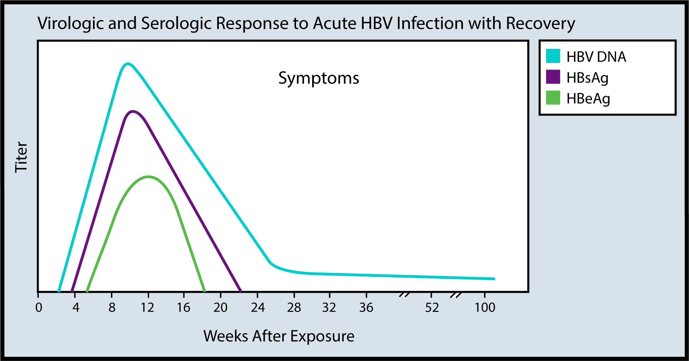
Illustration Credit: Peter E. Harrison, MPH
Notes:
This figure shows what markers show up first with acute infection.
Here in Purple is the surface antigen
This is one of the first serologic markers to appear in a new acute infection, and can be detected as early as 1 week and as late as 9 weeks with an average of one month after exposure to virus. How long this sticks around can vary from person to person.
Among recently infected persons who go on to clear the virus, about 50% will eventually test negative for HBsAg and HBV DNA 7 weeks after symptoms.

Slide 11
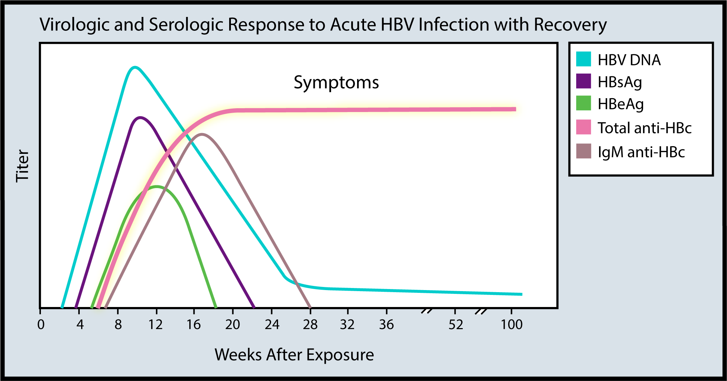
Illustration Credit: Peter E. Harrison, MPH
Notes:
The Core antibody here in pink is one of the first antibodies to show up in an individual infected by the virus.
It remains detectable in the blood in the vast majority of individuals – indefinitely for the remainder of their lives.

Slide 12
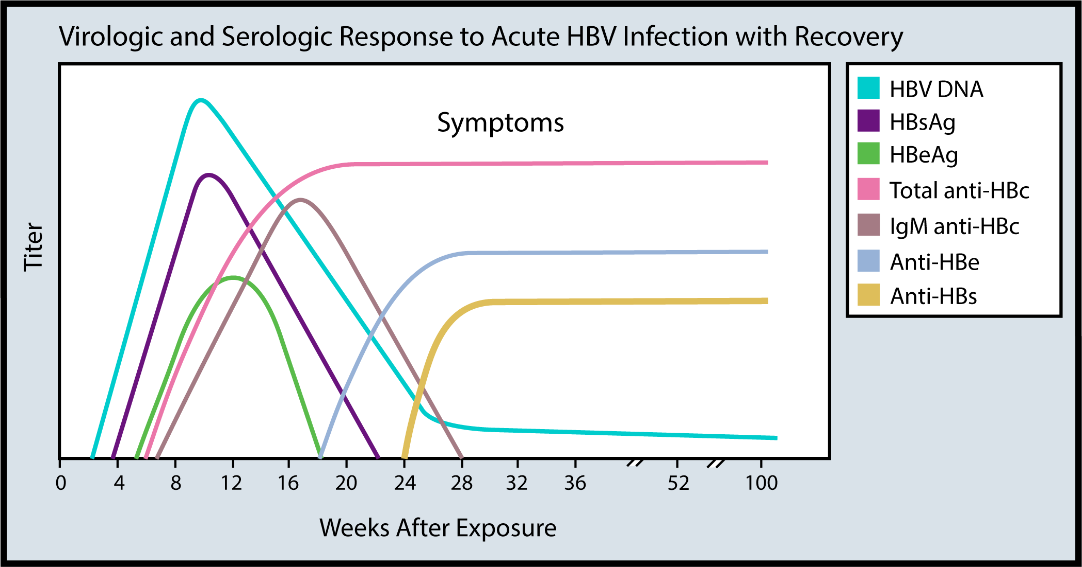
Illustration Credit: Peter E. Harrison, MPH
Notes:
Here in gold is the surface antibody
this becomes detectable on a blood test after the disappearance of HBsAg in persons who are able to get rid of the virus and avoid a chronic infection.
The presence of anti-HBs following a new acute infection generally indicates recovery and a person is then protected (or “immune”) from re-infection with hepatitis B.

Slide 13
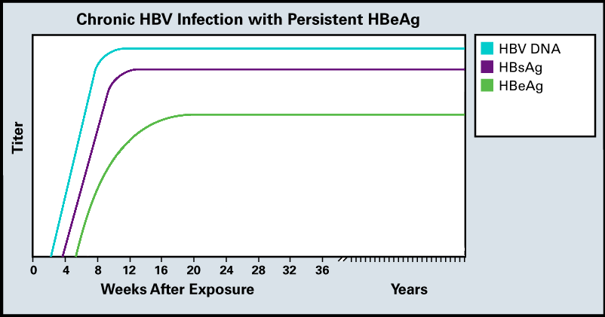
Illustration Credit: Peter E. Harrison, MPH
Notes:
In contrast, the person who becomes exposed to the virus and is unable to mount an effective immune response will continue to have lingering detection of the markers of active infection:
HBsAg, HBV DNA and HBeAg

Slide 14
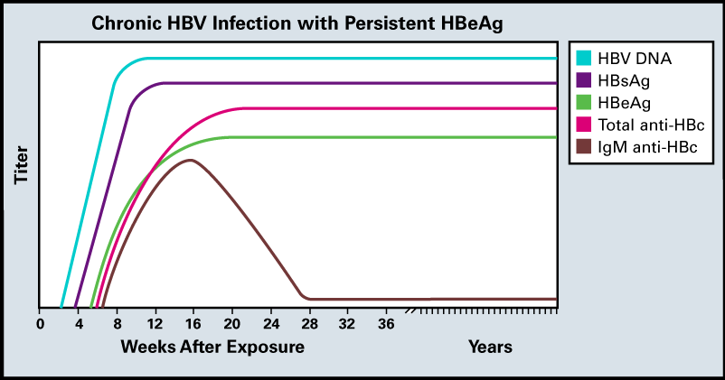
Illustration Credit: Peter E. Harrison, MPH
Notes:
And while the core antibody eventually shows up in these individuals (both as IgG and IgM initially)
There is no sign of that gold line for surface antibody

Slide 15
Hepatitis B Serologies
Profile | HBsAg | Total core Ab | Anti-HBs | Core IgM Ab | HBV DNA
Never infected (susceptible)
Acute infection
Recovery from past infection
Chronic infection
Isolated core antibody
Immunized (or passive Ab receipt)
Notes:
Once you understand this evolution, you can distinguish various profiles based on the pattern of serologic markers. As a reminder, the best set of tests to sort out these profiles is the standard trio of sAg, cAb and sAb.
Core IgM Ab and HBV DNA and other tests are considered secondary diagnostic tests. I have included these here to underscore differences in a few of these profiles but they are not always needed.

Slide 16
Hepatitis B Serologies
Profile | HBsAg | Total core Ab | Anti-HBs | Core IgM Ab | HBV DNA
Never infected (susceptible) | - | - | - | - | -
Acute infection
Recovery from past infection
Chronic infection
Isolated core antibody
Immunized (or passive Ab receipt)
Notes:
For someone who was never infected or vaccinated, they should be negative for all of the seromarkers. This is the individual who needs to get immunized.

Slide 17
Hepatitis B Serologies
Profile | HBsAg | Total core Ab | Anti-HBs | Core IgM Ab | HBV DNA
Never infected (susceptible) | - | - | - | - | -
Acute infection | + | + | - | + | +
Recovery from past infection
Chronic infection
Isolated core antibody
Immunized (or passive Ab receipt)
Notes:
For someone who is acutely infected, we should see evidence of HB surface antigen and HBV DNA in blood, as well as core IgM Ab and total core Ab.
Most of these individuals will NOT yet show evidence of surface antibody.

Slide 18
Hepatitis B Serologies
Profile | HBsAg | Total core Ab | Anti-HBs | Core IgM Ab | HBV DNA
Never infected (susceptible) | - | - | - | - | -
Acute infection | + | + | - | + | +
Recovery from past infection | - | + | + | - | -
Chronic infection
Isolated core antibody
Immunized (or passive Ab receipt)
Notes:
For those who go on to clear their acute hepatitis B, we should eventually see lingering presence of core Ab and surface Ab,
but all the other markers of active infection: HBsAg, core IgM and HBV DNA should be absent.

Slide 19
Hepatitis B Serologies
Profile | HBsAg | Total core Ab | Anti-HBs | Core IgM Ab | HBV DNA
Never infected (susceptible) | - | - | - | - | -
Acute infection | + | + | - | + | +
Recovery from past infection | - | + | + | - | -
Chronic infection | + | + | - | - | +
Isolated core antibody
Immunized (or passive Ab receipt)
Notes:
Chronic infection on other hand will have persistent hepatitis B surface antigen and most of those not on therapy will have HBV DNA detected in blood.
In contrast to our patient with resolved infection, they will not have surface antibody but will have core Ab.

Slide 20
Hepatitis B Serologies
Profile | HBsAg | Total core Ab | Anti-HBs | Core IgM Ab | HBV DNA
Never infected (susceptible) | - | - | - | - | -
Acute infection | + | + | - | + | +
Recovery from past infection | - | + | + | - | -
Chronic infection | + | + | - | - | +
Isolated core antibody | - | + | - | - | +/-
Immunized (or passive Ab receipt)
Notes:
The patient with isolated core antibody is typically someone who has waning of their surface antibody over time. Many of these individuals have seen the virus before and are effectively immune to HBV when exposed. A much smaller subset of isolated core Ab patients are those who have previously had chronic infection with a virus that evolves to lose its ability to produce surface Ag. These individuals with occult hep B are distinguished from hep B immune patients by the presence of HBV DNA.

Slide 21
Hepatitis B Serologies
Profile | HBsAg | Total core Ab | Anti-HBs | Core IgM Ab | HBV DNA
Never infected (susceptible) | - | - | - | - | -
Acute infection | + | + | - | + | +
Recovery from past infection | - | + | + | - | -
Chronic infection | + | + | - | - | +
Isolated core antibody | - | + | - | - | +/-
Immunized (or passive Ab receipt) | - | - | + | - | -
Notes:
And finally, the individual who was immunized against hepatitis B should only have surface antibody but nothing else present in their blood.
So that is hepatitis B serologies – there may be exceptions to these rules when you encounter a patient who has a false positive (which occasionally happens) or in those who are transitioning from one phase to another but for the vast majority of patients, they should fall into one of these categories.

Slide 22
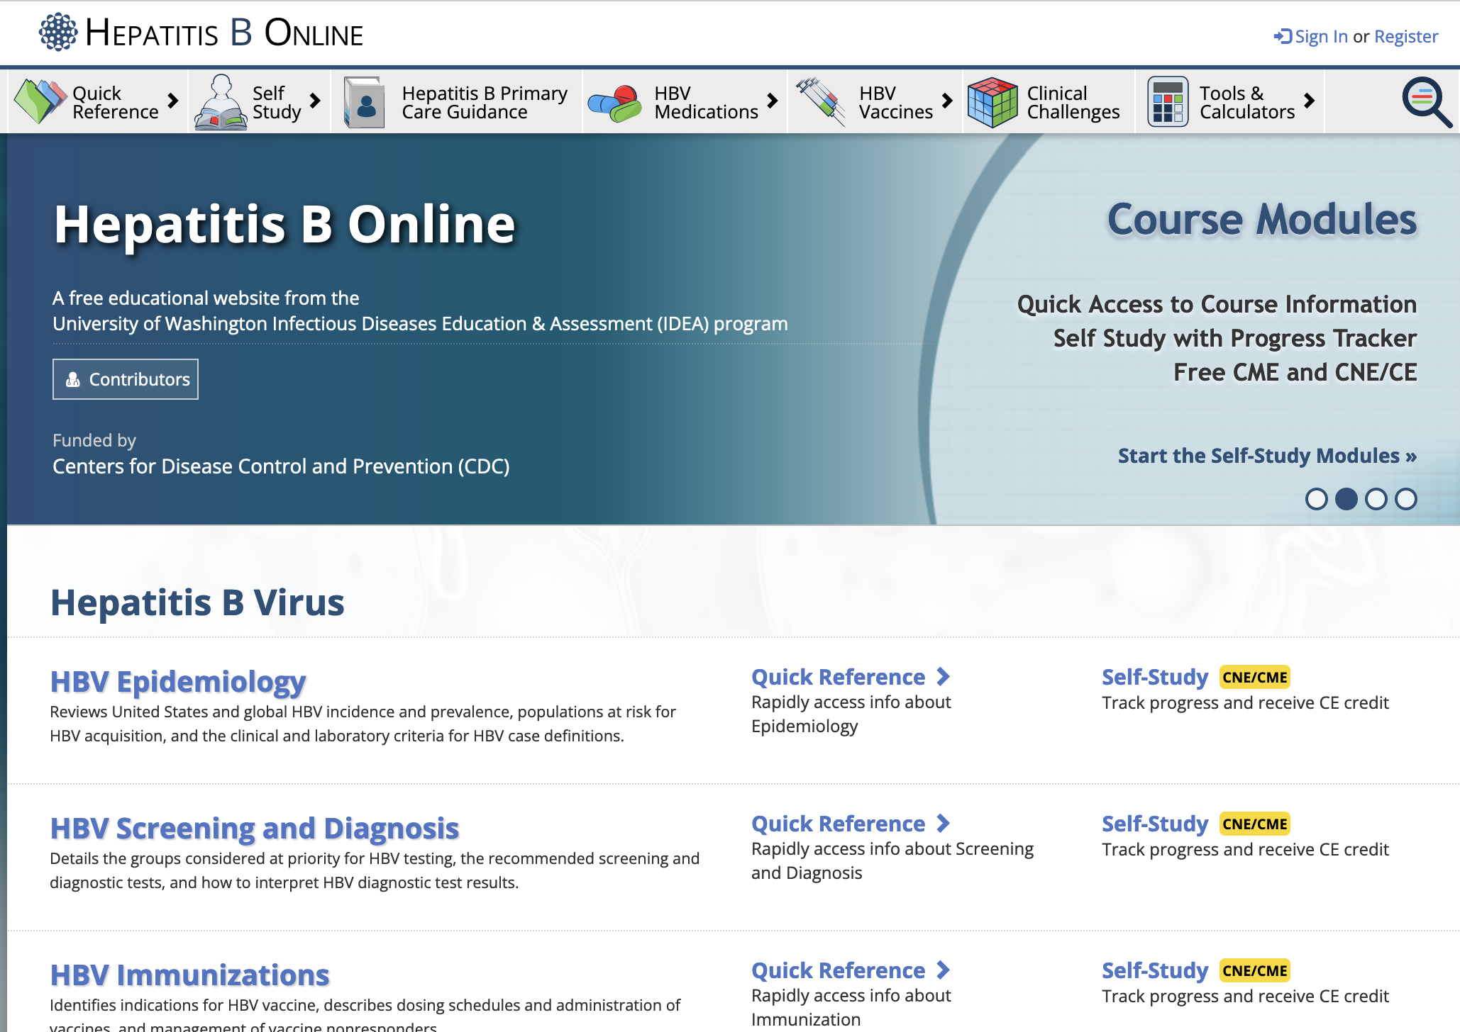
www.hepatitisb.uw.edu
Notes:
To learn about hepatitis B, please check out our Hepatitis B online curriculum which contains a variety of lessons, cases & slides to reinforce your knowledge.
Thanks for joining me today.

