Slide 1
Isolated Hepatitis B Core Antibody
H. Nina Kim, MD MSc
Professor of Medicine
University of Washington
Last Updated: October 7, 2022
Notes:
Hello! My name is Dr. Nina Kim from the University of Washington. I will be talking about a frequently encountered hepatitis B serologic profile – isolated core Ab. This occurs when someone is only positive for hepatitis B core Ab and negative for surface antigen and surface antibody. This profile tends to generate confusion and questions for many clinicians. By the end of this talk, you will gain better understanding of isolated core antibody.

Slide 2
Disclosures
H. Nina Kim, MD MSc
Gilead Sciences provides program funding to my institution

Slide 3
Topics
Virology and definition
When isolated anti-HBc is encountered
Clinical significance
Occult HBV infection
HBV reactivation
HBV immunization
Notes:
These are some of the key points I want to cover today. We’ll walk thru some virology & definitions, talk about the scenarios that lead to this serologic profile, and what the clinical implications may be, esp. with respect to occult HBV, HBV reactivation and immunization.

Slide 4
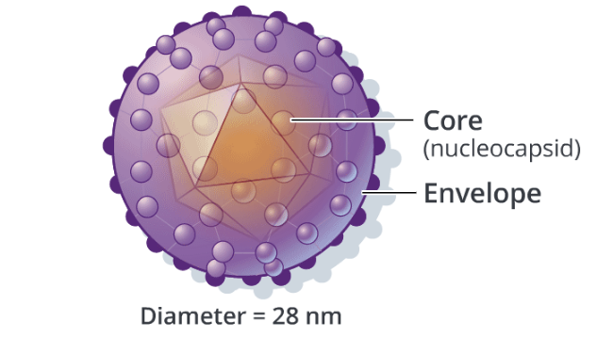
Hepatitis B Virus: Key Structures
Hepatitis B surface Ag
Image Credit: Cognition Studios, Inc.
Notes:
Hepatitis B is partially double-stranded DNA virus. The main marker of active infection is the HB surface antigen. This is lipoprotein – it is a component of the envelope and is the major site for binding of neutralizing antibody.

Slide 5
Hepatitis B Virus: E antigen and Core antigen
Image Credit: Cognition Studios, Inc.
Notes:
In addition to the surface antigen, the virus produces 2 nucleocapsid proteins: HBeAg and core Ag.
Hep B e antigen is secreted into the circulation while the hep B core antigen is assembled to form the viral core which is then later packaged as part of the intact hep B virion.

Slide 6
Hepatitis B Virus: E antigen and Core antigen
Image Credit: Cognition Studios, Inc.
Notes:
In addition to the surface antigen, there are 2 nucleocapsid proteins: HBeAg and core Ag.
Hep B e antigen is secreted into the circulation while the hep B core antigen is assembled to form the viral core which is then later packaged as part of the intact hep B virion.
For this reason… We are able to measure e antigen directly in blood but unable to measure core Ag.

Slide 7
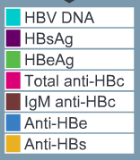
Natural History of Acute Resolved HBV
Image Credit: Cognition Studios, Inc.
Notes:
So this is the serologic pattern that evolves during acute hep B infection that goes on to resolution.
These 3 paralleling lines here are the 3 main antibodies produced by the host after infection… core Ab, e Ab and surface Ab.
You can see here that the total anti-core Ab (pink) shows up relatively early in infection and persists at stable levels long past the initial infection.

Slide 8
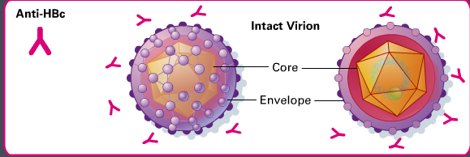
Core Antibody
Image Credit: Cognition Studios, Inc.
Notes:
Clinicians have sometimes confused core Ab with core Ag – remember: we cannot measure core Ag... We can only measure the Ab – so on its own, it does not necessarily indicate active infection.
It simply reflects the fact that the individual has seen the actual virus at some point in their lives. So an immunized individual or an individual who has never been exposed to natural infection would not have core Ab.
The other point of distinction is that core Ab should not be confused with surface Ab. In contrast to surface Ab, core Ab does not necessarily indicate immune protection. Just prior exposure to the virus.

Slide 9
Isolated Hepatitis B Core Antibody
Definition: Anti-HB core Ab(+) but anti-HBs and HBs antigen negative
Common profile
20-45% in persons with HIV and 5-31% in persons without
Factors associated with isolated core Ab:
Chronic hepatitis C infection
Injection drug use; multiple sex partners
Older age
HIV: CD4 count <100 cells/mm³, HIV viremia
Source: Chang et al, Current HIV/AIDS Reports.2018:15;172–81.
French, J Infect Dis 2007;195:1437-42.
Tsui, Clin Infect Dis 2007;45:736-40.
Palacios, HIV Clin Trials 2008;9:337-40.
Chang, Curr HIV/AIDS Report 2018;15:172-81.
Notes:
An individual with isolated core antibody by definition has positive core Ab in the absence of surface antigen or surface antibody (the other hep B seromarkers).

Slide 10
Isolated Hep B Core: Four Scenarios
Window phase of acute infection
Resolved HBV infection with waning anti-HBs
Occult HBV with loss of HBsAg
False positive
Notes:
This isolated core profile is seen 1 of 4 scenarios:
Window phase – a period of time when surface antigen has basically gotten to below detectable levels and the surface antibody has not yet quite developed and it is in the seronegative window where you can sometimes just get isolated core antibody. Keep in mind that you will not encounter this very often (short discrete transient phase) individual likely has other clinically apparent manifestations of acute hep B including elevated liver aminotransferases. They will also likely have positive core IgM antibody.
The second scenario is when you have someone who has seen hepatitis B and they have gone on to resolve their infection but they basically had waning of their surface antibody to a level that is less than 10-12 international units/L which, depending on the assay, is the threshold we consider protective.
3rd: chronic infection that can manifest as an isolated core Ab when the surface antigen has waned over time due to low production... we can sometimes see this in chronic carrier state they have started to gain some better immune control and therefore lost surface antigen or they have developed mutations to the surface Ag protein that have escaped detection by our standard assays.
Finally, false positive. I want to say a few words about false positive. Because one of the misconceptions out there is that most individuals with this isolated core Ab profile fall into this category.

Slide 11
Isolated Hep B Core: Four Scenarios
Window phase of acute infection
Resolved HBV infection with waning anti-HBs
Occult HBV with loss of HBsAg
False positive
Notes:
This isolated core profile is seen 1 of 4 scenarios:
Window phase – a period of time when surface antigen has basically gotten to below detectable levels and the surface antibody has not yet quite developed and it is in the seronegative window where you can sometimes just get isolated core antibody. Keep in mind that you will not encounter this very often (short discrete transient phase) individual likely has other clinically apparent manifestations of acute hep B including elevated liver aminotransferases. They will also likely have positive core IgM antibody
The second scenario is when you have someone who has seen hepatitis B and they have gone on to resolve their infection but they basically had waning of their surface antibody to a level that is less than 10-12 international units/L which, depending on the assay, is the threshold we consider protective.
3rd: chronic infection that can manifest as an isolated core Ab when the surface antigen has waned over time due to low production... we can sometimes see this in chronic carrier state they have started to gain some better immune control and therefore lost surface antigen or they have developed mutations to the surface Ag protein that have escaped detection by our standard assays.
Finally, false positive.

Slide 12
Isolated Hep B Core: Four Scenarios
Window phase of acute infection
Resolved HBV infection with waning anti-HBs
Occult HBV with loss of HBsAg
False positive
Notes:
This isolated core profile is seen 1 of 4 scenarios:
Window phase – a period of time when surface antigen has basically gotten to below detectable levels and the surface antibody has not yet quite developed and it is in the seronegative window where you can sometimes just get isolated core antibody. Keep in mind that you will not encounter this very often (short discrete transient phase) individual likely has other clinically apparent manifestations of acute hep B.
The second scenario is when you have someone who has seen hepatitis B and they have gone on to resolve their infection but they basically had waning of their surface antibody to a level that is less than 10-12 international units/L which, depending on the assay, is the threshold we consider protective.
3rd: chronic infection that can manifest as an isolated core Ab when the surface antigen has waned over time due to low production... we can sometimes see this in chronic carrier state they have started to gain some better immune control and therefore lost surface antigen or they have developed mutations to the surface Ag protein that have escaped detection by our standard assays.
Finally, false positive.

Slide 13
Isolated Hep B Core: Four Scenarios
Window phase of acute infection
Resolved HBV infection with waning anti-HBs
Occult HBV with loss of HBsAg
False positive
Notes:
This isolated core profile is seen 1 of 4 scenarios:
Window phase – a period of time when surface antigen has basically gotten to below detectable levels and the surface antibody has not yet quite developed and it is in the seronegative window where you can sometimes just get isolated core antibody. Keep in mind that you will not encounter this very often (short discrete transient phase) individual likely has other clinically apparent manifestations of acute hep B.
The second scenario is when you have someone who has seen hepatitis B and they have gone on to resolve their infection but they basically had waning of their surface antibody to a level that is less than 10-12 international units/L which, depending on the assay, is the threshold we consider protective.
3rd: chronic infection that can manifest as an isolated core Ab when the surface antigen has waned over time due to low production... we can sometimes see this in chronic carrier state they have started to gain some better immune control and therefore lost surface antigen or they have developed mutations to the surface Ag protein that have escaped detection by our standard assays.
Finally, false positive.

Slide 14
Isolated Hep B Core: Four Scenarios
Window phase of acute infection
Resolved HBV infection with waning anti-HBs
Occult HBV with loss of HBsAg
False positive
Notes:
This isolated core profile is seen 1 of 4 scenarios:
Window phase – a period of time when surface antigen has basically gotten to below detectable levels and the surface antibody has not yet quite developed and it is in the seronegative window where you can sometimes just get isolated core antibody. Keep in mind that you will not encounter this very often (short discrete transient phase) individual likely has other clinically apparent manifestations of acute hep B.
The second scenario is when you have someone who has seen hepatitis B and they have gone on to resolve their infection but they basically had waning of their surface antibody to a level that is less than 10-12 international units/L which, depending on the assay, is the threshold we consider protective.
3rd: chronic infection that can manifest as an isolated core Ab when the surface antigen has waned over time due to low production... we can sometimes see this in chronic carrier state they have started to gain some better immune control and therefore lost surface antigen or they have developed mutations to the surface Ag protein that have escaped detection by our standard assays.
Finally, false positive. I want to say a few words about false positive. Because one of the misconceptions out there is that most individuals with this isolated core Ab profile fall into this category. When in fact this is rare. We did encounter false positives with older assays but current assays for hep B core Ab have >99% specificity. But you want to consider the possibility of this false result if you have a patient with no risk factors for HBV and who is not from an HBV endemic region such as Asia, Africa or Pacific Islands.

Slide 15
Isolated Hep B Core: Clinical Significance
Stable pattern over time in most individuals
Still present if retested
If changes → transition to natural immunity (+anti-HBc and +anti-HBs)
Transition to chronic hep B (gain/loss of HBsAg) is rare
Not usually associated with:
ALT/AST elevations
Liver stiffness by FibroScan
Cirrhosis or HCC
Secondary transmission
Source Witt MD, et al. Clin Infect Dis. 2013;56:606–12.
Notes:
What we have learned about this profile is that it is generally a stable pattern over time in most individuals.
In one large cohort of individuals with and without HIV, this profile continued to be present in the vast majority of individuals when retested.
If there was a change, the surface Ab would show up. It was rare to see a transition to a chronic hepatitis B profile, where the surface antigen was positive along the core Ab.
We have also learned that this profile does not appear to be associated (at least in US-based settings) with liver aminotransferase elevations…

Slide 16
Isolated Hepatitis B Core Antibody Occult Hepatitis B
Isolated core Ab (+), negative surface Ag with (+) HBV DNA level
Prevalence variable (geography, population & assays differ)
Estimated prevalence ~2-41% among isolated core pts
True prevalence may be underestimated due to
Cross-sectional nature of many studies
Fact that patients may be on HBV-active antivirals (HIV cohorts)
HBV viral levels detected typically low (<1000 IU/mL range) but also quite variable.
Source: Wu T, et al. Am J Gastroenterol. 2017;112:1780–8.
Chang JJ, et al. Current HIV/AIDS Reports. 2018;15:172–81.
Notes:
But what about that small subset with occult hep B?
Bottom line: I think the clinical significance and true extent of occult HBV is not clear based on the literature. Answer to question – how worried should I be for occult HBV in isolated core patients... is generally going to be: don’t worry
How aggressively we hunt for this will depend a great deal on 2 things: (1) where the patient is from and (2) what is at stake clinically? I tend to be more aggressive about hunting or watching for occult HBV when the clinical stakes are high.

Slide 17
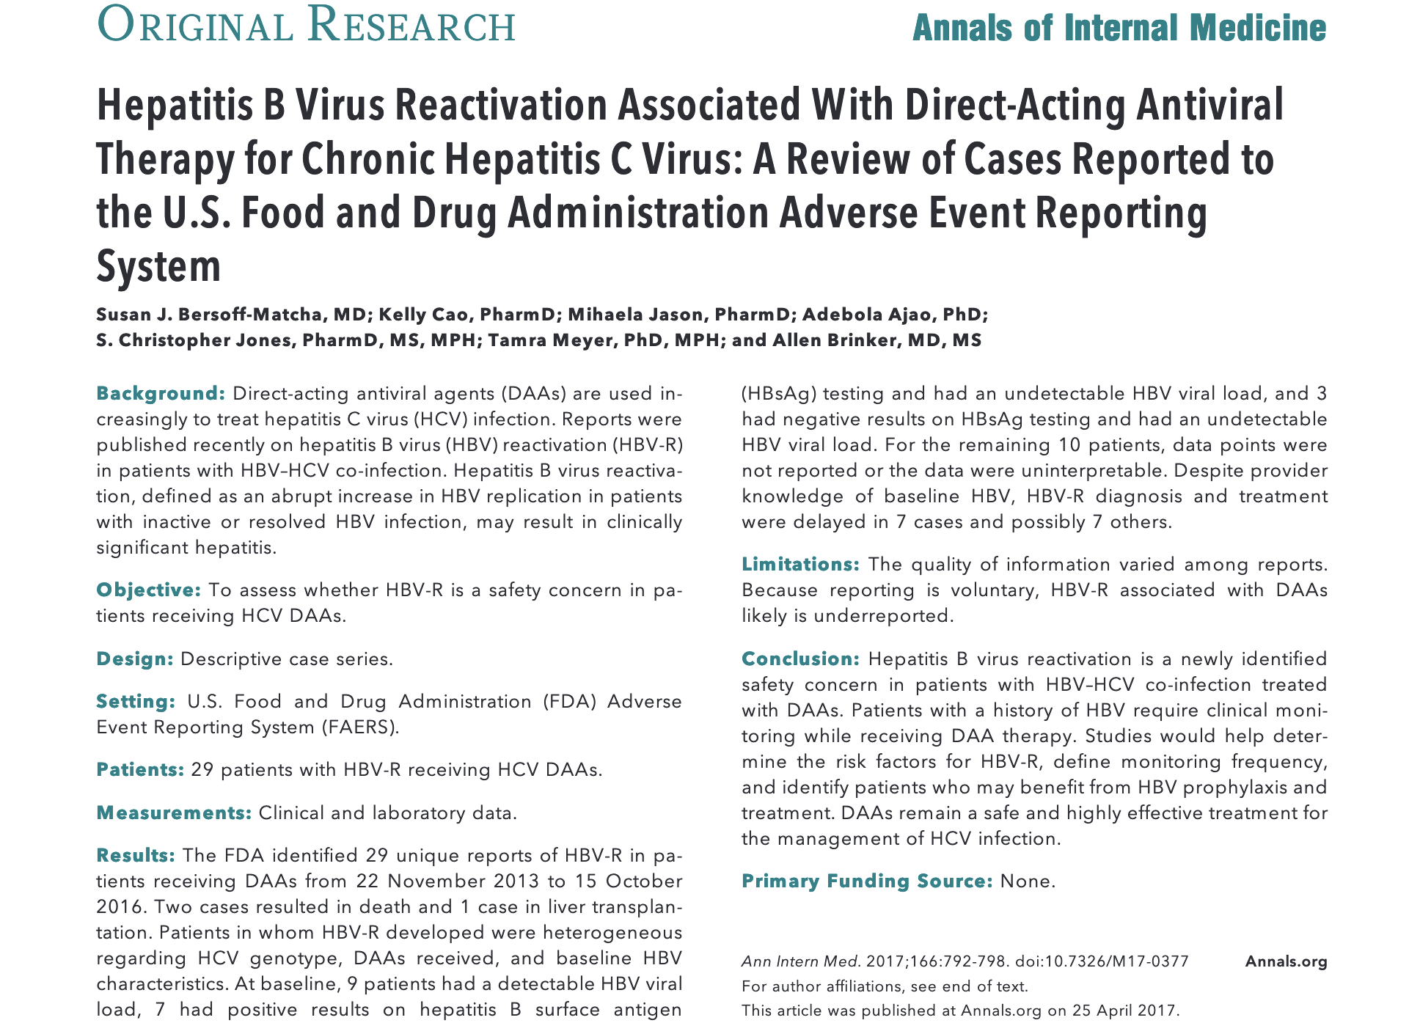
Notes:
Reports of severe HBV reactivation in the setting of HCV treatment. Which we did not see in the interferon era – probably because IFN has activity vs HBV.
In October of 2016, the US Food and Drug Administration issued a drug safety Boxed Warning after identifying 29 cases of HBV reactivation in hepatitis B and C co-infected patients undergoing treatment with HCV direct-acting antiviral (DAA) therapies. Later published on these cases in the Annals the following spring.
To understand why this can happen, appreciate phenomenon of viral interplay between HCV and HBV: HCV exerts an inhibitory effect on HBV, as evidenced by studies finding lower HBV viral loads in co-infection when compared with HBV monoinfected individuals. So when you take HCV out of the equation, there is an alteration in this immune synergy: HBV has the potential to come back in a fulminant way.

Slide 18
Isolated anti-HBc in DAA Therapy
HBV reactivation with DAA therapy much rarer than w/ chronic hep B
Estimated incidence 14% among chronic HBV (95% CI 8-22).
Only 3 cases of occult HBV reactivating with DAAs
Insufficient data to provide clear recommendations
AASLD/IDSA HCV guidance on isolated core:
“However, the possibility of HBV reactivation should be considered in these patients in the event of an unexplained increase in liver aminotransferase levels during and/or after completion of DAA therapy.”
Source: Wu T, et al. Am J Gastroenterol. 2017;112:1780–8.
Belperio PS, et al. Hepatology 2017;66:27–36.
Chen G, et al. Hepatology. 2017;66:13–26.
AASLD/IDSA HCV Guidance. Accessed at www.hcvguidelines.org
Notes:
Of note, these guidelines do not necessarily recommend checking baseline HBV DNA level to screen for occult HBV in these isolated core Ab patients who will undergo DAA therapy. This is left at the discretion of the clinician.

Slide 19
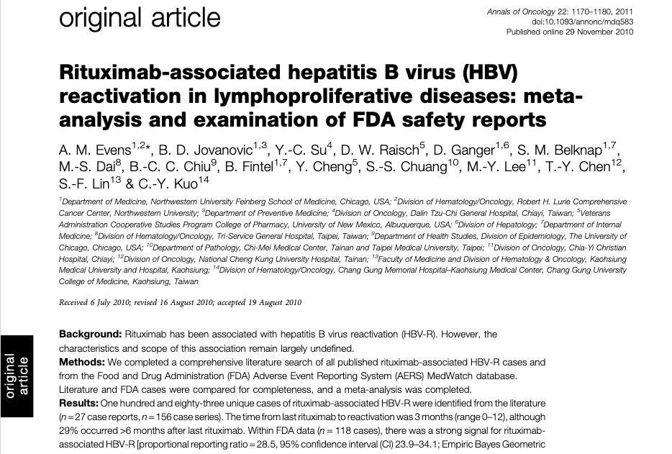
Notes:
The other high stakes situation where HBV reactivation can occur is when you give B cell depleting immunosuppressive therapy. Rituximab – as many of you know is a favored component of lymphoma tx – anti-CD20 monoclonal Ab. It turns out when you disable B cell lymphocyte activity in the way you do with rituximab... You can open the door to severe HBV reactivation. You can also see HBV reactivation with other forms of chemotherapy such as with anthracyclines or other forms of immunosuppression such as TNF alpha inhibition.
The key thing to be aware of is that this phenomenon of HBV reactivation has been reported to occur not just in patients who are known to have chronic HBV (who are at highest risk) but even in patients with isolated core Ab. The presence of HBV DNA (which would indicate occult HBV) can be a predictor for HBV reactivation in such settings.
How to manage the potential of HBV reactivation is beyond the scope of this talk but it is important to be aware when you have to pay extra attention to the isolated core Ab status.

Slide 20
HBV Immunization for Isolated Core Ab
No evidence to support routine “boosting”
Remember: most of these individuals are already infected with HBV
Most have waned anti-HBs but this does not mean they won’t mount a protective immune response to future exposure
Occult HBV: benefit of immunization is not clear
Immunization should be reserved for
False positive anti-HBc (no HBV risk factors, not from HBV endemic region)
People with HIV
Source: Terrault N, et al. Hepatol. 2018;67:1560–99.
Weng M, et. al. MMWR Morb Mortal Wkly Rep 2022;71:477–483.
Notes:
So the question often comes up – should we be immunizing these individuals with isolated core Ab?
There is no evidence to support routinely boosting these individuals. Remember – most of them have already been exposed to the virus so immunizing against primary infection seems counterproductive. And remember that the majority of them have waned surface Ab. Having these low levels of surface Ab does not mean they won’t mount a protective immune response when called upon to do so. The exception here might be persons with HIV who appear to have suboptimal anamnestic Ab response to HBV exposure.
Ultimately, immunization should be reserved for those with isolated core Ab whom you suspect may have a false positive (these are individuals who in reality have no HBV exposure at baseline) or who have HIV. This is the person without risk factors – they have never used drugs, are not on dialysis or living in a correctional facility, have only had 1 lifetime sex partner etc. They are not from geographic regions such as Asia, Africa or Pacific Islands or from other parts of world that might have intermediate prevalence (2-8%) for hep B: parts of E Europe or S America.
So you might ask why should I immunize someone with no HBV risk factors? Well, the CDC has issued a recommendation in 2022 to immunize all adults aged 19-59 regardless of risk factors.
This person whom you suspect has a false positive core Ab – if they fall into this age bracket, should ideally receive a full HBV vaccine series.

Slide 21
Take Aways: Isolated Hep B Core Ab
The core antibody is most sensitive marker of prior exposure to the hepatitis B virus.
This does not necessarily indicate active infection or immunity but most are likely to be immune (with waned anti-HBs).
Consider occult HBV and the possibility of HBV reactivation
Hepatitis C treatment with DAAs or B cell depleting immunologic therapy
Esp. if individual is from HBV-endemic region (e.g. Asia or Africa)
Immunize if they meet criteria for false positive or have HIV.
Notes:
So in summary…

Slide 22
www.hepatitisb.uw.edu
Notes:
To learn about hepatitis B, please check out our Hepatitis B online curriculum which contains a variety of lessons, cases & slides to reinforce your knowledge.
Thanks for joining me today.

