Slide 1
Hepatitis B Hepatocellular Carcinoma Screening
Prepared by:
H. Nina Kim, MD, MSc
Associate Editor, Hepatitis B Online and Hepatitis C Online
Professor of Medicine
Division of Allergy & Infectious Diseases
University of Washington
Last Updated: June 16, 2023
Notes:
Hello! I’m Dr. Nina Kim from the University of Washington. Today I will be discussing hepatocellular carcinoma (or HCC) in the setting of chronic hepatitis B infection.

Slide 2
Disclosures
H. Nina Kim, MD MSc
Gilead Sciences provides program funding to my institution

Slide 3
Hepatocellular Carcinoma (HCC) due to Chronic Hepatitis B
Terminology
HCC epidemiology – global and US
Distinct oncogenic risk related to hepatitis B (HBV)
Evidence to support HCC screening
Who to screen
How to screen
Notes:
In this mini lecture, I will take a brief moment to go over the terminology of liver cancer. I will then review the global epidemiology of liver cancer before touching on related mortality in the US.
Hepatitis B has distinct features that promote the pathogenesis of HCC and we will review that as well.
I will discuss the evidence base to support HCC screening.
And finally, the indications for screening – specifically who to screen – as well as the available and recommended methods of screening – specifically how to screen

Slide 4
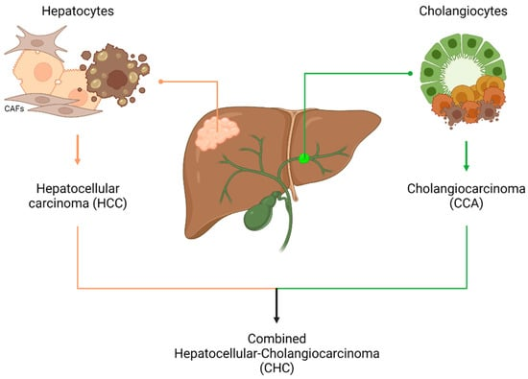
Terminology of primary liver cancer
Source: Int. J. Mol. Sci. 2023, 24(5), 4529.
Notes:
Primary liver cancer refers to malignant tumors that arise from within the organ itself rather than from distant metastases.
There are 3 forms of primary liver cancer – hepatocellular carcinoma (originating from hepatocytes), cholangiocarcinoma (originating from biliary cells or cholangiocytes) and a rare form of combined HCC-cholangiocarcinoma.
HCC is responsible for the vast majority of primary liver cancer (85-90%) and will be the focus of this talk.

Slide 5
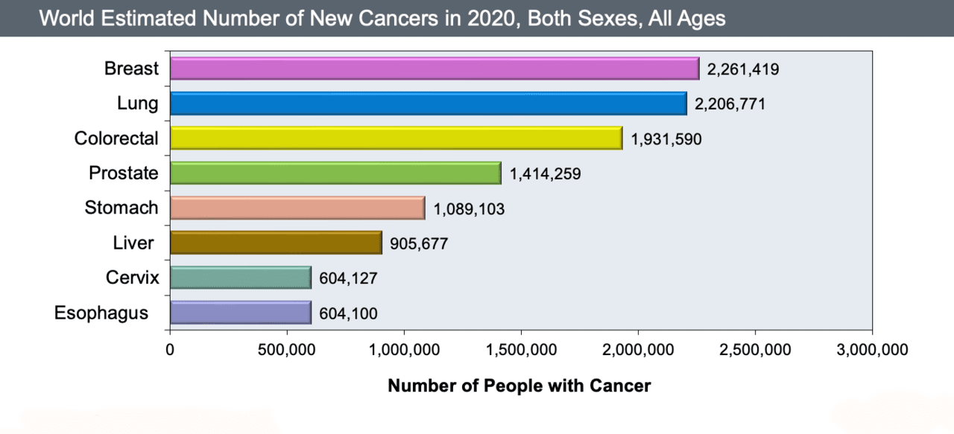
Liver Cancer – Among the leading cancers worldwide
Source: World Health Organization. Liver Fact Sheet: Globocan, 2020. WHO’s International Agency for Research on Cancer.
Notes:
Primary liver cancer of any cause (whether it is chronic hep B or another) is a leading cancer worldwide.
And ranks 6th in highest incidence of cancers according to the WHO in 2020.

Slide 6
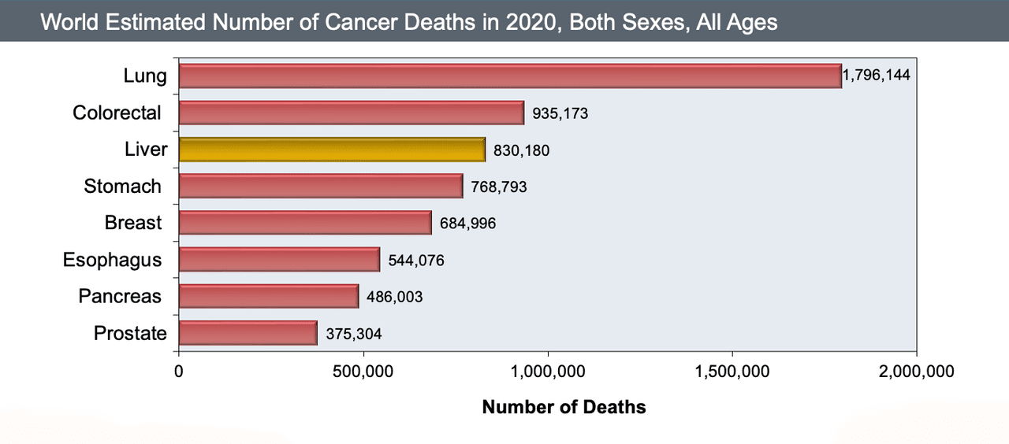
Liver Cancer – 3rd leading cause of cancer death
Source: World Health Organization. Liver Fact Sheet: Globocan, 2020. WHO’s International Agency for Research on Cancer.
Notes:
It can be a lethal cancer, and is the 3rd leading cause of cancer-related deaths worldwide – surpassed only by lung and colorectal cancer.

Slide 7
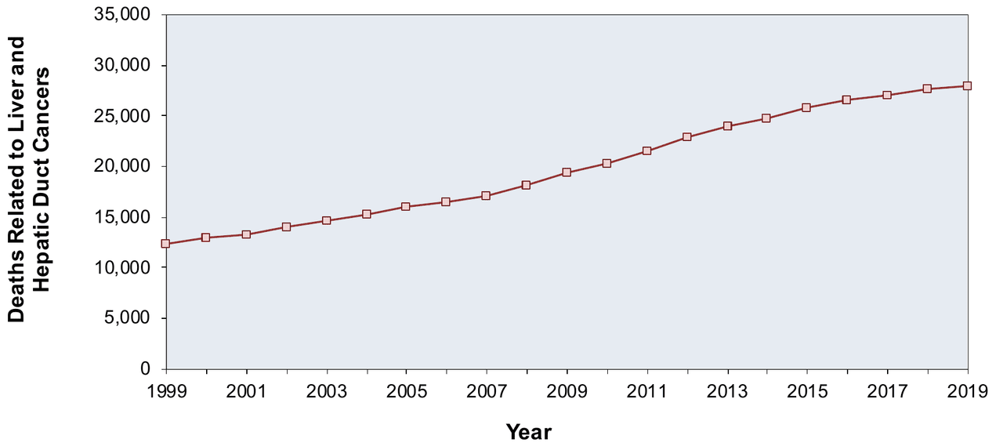
HCC-related deaths, 1999-2019 in US
Source: U.S. Cancer Statistics Working Group. U.S. Cancer Statistics Data Visualizations Tool, based on 2021 submission data (1999-2019): U.S. Department of Health and Human Services, Centers for Disease Control and Prevention and National Cancer Institute. Released June 2022.
Notes:
Incidence of HCC has tripled in the last few decades in the United States and because of the lethal nature of this cancer, the mortality trends have matched the incidence as you can see here.
The overall 5-year survival is 21% according to the 2020 US SEER data collected by National Cancer Institute.

Slide 8
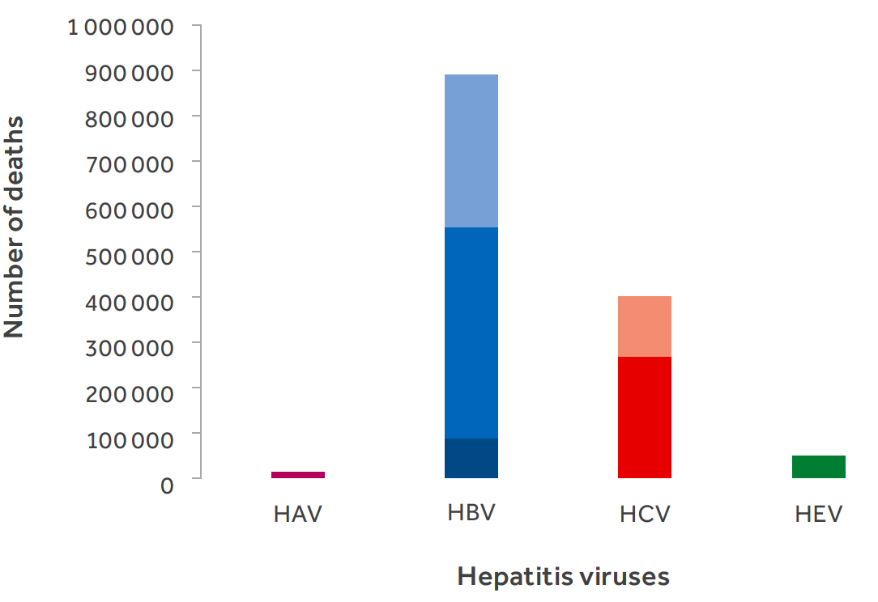
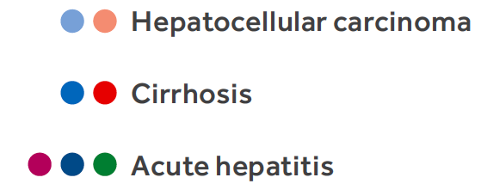
Deaths from Viral Hepatitis: Role of HBV-related HCC
Source: World Health Organization, Global Hepatitis Report, 2017.
Notes:
The burden of hepatocellular carcinoma can also be viewed from this graphic from the WHO Global Hepatitis Report.
You can see that chronic hepatitis B carries the lion’s share of deaths attributable to viral hepatitis, and that among causes of death,
HCC has a sizable contribution at over a third of the HBV-associated deaths.

Slide 9
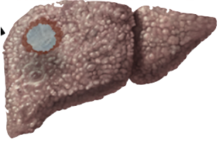
Mechanisms for HBV Oncogenesis
Chronic inflammation
Hepatic injury & cell turnover
Cirrhosis
HBV integration into host genome
Genomic instability
HBV-related gene products with oncogenic potential
HCC
Adapted from: Wangensteen et al, Hepatol. 2021;73 (Suppl):27-37
Notes:
Hepatitis B virus can promote hepatocarcinogenesis through multiple mechanisms. Like chronic hepatitis C, HBV can contribute to cancer development via the fibrotic pathway: chronic inflammation, recurrent hepatic injury and cell turnover. But unlike hep C, HBV can integrate itself into the host genome and in doing so cause genomic instability as well as gene products like the HBx protein that have distinct oncogenic potential.
So this is why hepatitis B can promote liver cancer in the absence of cirrhosis – although the vast majority of HCC cases from hep B are in patients with advanced fibrosis.

Slide 10
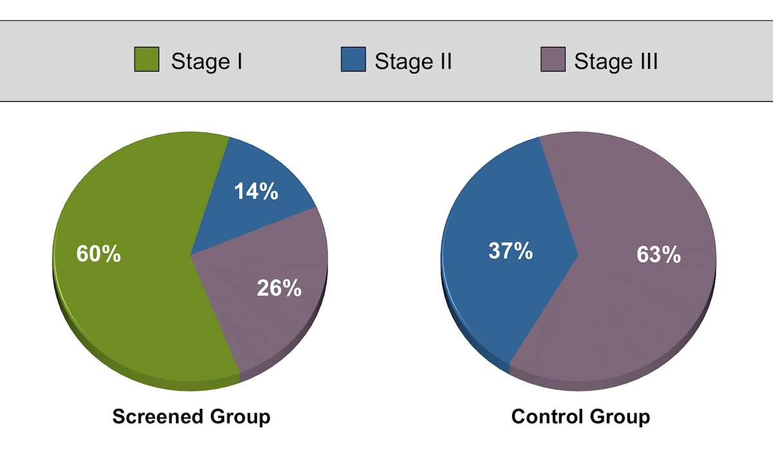
Cluster randomized trial of HCC screening
Source: Zhang et al, J Cancer Res Clin Oncol. 2004;130:417-22.
Notes:
As for evidence to support HCC screening… the best known study is a cluster-randomized, controlled trial conducted in China that assessed the impact of screening on HCC-related mortality. This study enrolled over 18K individuals with chronic HBV aged 35 to 59 from 300 factories, businesses and schools in urban Shanghai. Half of these units were randomized to screening using serum alfa-fetoprotein (AFP) and ultrasound every 6 months; the other arm underwent usual care without screening. One of the most notable outcomes was that HCC was diagnosed at an earlier stage in the screened group, as shown here.

Slide 11
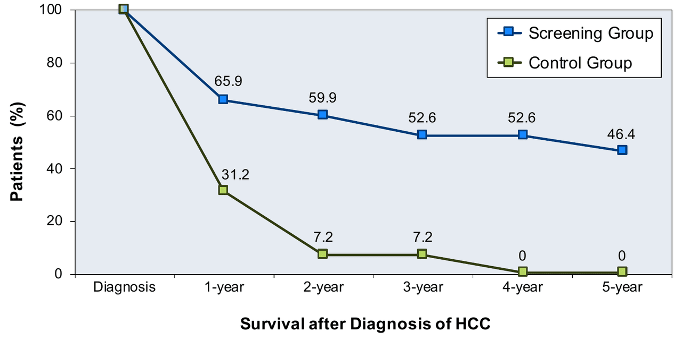
Cluster randomized trial of HCC screening
Source: Zhang et al, J Cancer Res Clin Oncol. 2004;130:417-22.
Notes:
Ultimately, the screening group had a lower HCC-related 5-year mortality rate compared with the control group.
There were some methodologic flaws to this study that placed it at high risk for bias that I won’t go into but there have been several observational studies of patients with cirrhosis that have since shown that surveillance for HCC is associated with early-stage tumor detection and improved survival even after adjusting for measurable confounding factors.

Slide 12
Who to Screen for HCC in Persons with chronic HBV (AASLD)
All persons with cirrhosis
Black males older than 40 years of age
Asian males older than 40 years of age
Asian females older than 50 years of age
Persons with 1st degree family member with history of HCC
Persons with hepatitis delta coinfection
Source: AASLD 2018 Hepatitis B Guidance
Notes:
The American Association for the Study of Liver Diseases (or AASLD) recommends HCC screening for the following people with chronic hep B:
* All persons with cirrhosis – this remains one of the strongest risk factors for HCC among people with chronic HBV.
HCC incidence in persons with cirrhosis is 2.2 to 4.3 per 100 person-years versus 0.1 to 0.8 per 100 person-years in those without cirrhosis.
Among those without cirrhosis, there are some groups that are recommended to undergo screening based on age/race… these individuals carry a higher risk of HCC due to viral, host and epigenetic factors.
Patients with a family hx of HCC, specifically in a first-degree family member and those with hepatitis delta coinfection are also recommended to undergo HCC screening

Slide 13
Risk Factors for HCC
Host | Viral/Disease | Environmental/Exposure
Age >40 years Male sex Immune compromised | Presence of cirrhosis High HBV DNA level (>2000 IU/ml) Genotype C Longer duration of infection Concurrent viral infections (HIV, HCV, HDV) | Alcohol Metabolic syndrome (NAFLD, diabetes, obesity) Aflatoxin Smoking
Adapted from AASLD 2018 Hepatitis B Guidance
Notes:
There are a variety of other factors (that related to the host, the virus/disease and exposures) that are mentioned in the AASLD guidance that contribute to HCC risk and are worth considering as there is room for individualization when considering the decision to screen.

Slide 14
Who to Screen for HCC in Persons with chronic HBV (AASLD)
All persons with cirrhosis
Black males older than 40 years of age
Asian males older than 40 years of age
Asian females older than 50 years of age
Persons with 1st degree family member with history of HCC
Persons with hepatitis delta coinfection
Source: AASLD 2018 Hepatitis B Guidance
Notes:
But the aforementioned groups of individuals, in the previous slide, are the main indications for screening in the setting of chronic hepatitis B.

Slide 15
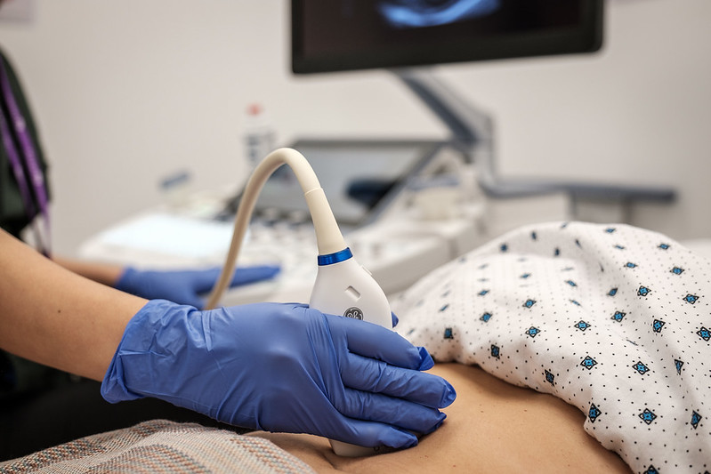
How to Screen: Abdominal Ultrasound every 6 months
Advantages
Inexpensive
No radiation or IV
Readily available
Well tolerated
Limitations
Operator dependent
Body habitus, hold breath
Liver factors (nodularity, steatosis)
Sensitivity ranges from 40-80%
Photo: https://ethnomed.org/resource/abdominal-ultrasound
Sources: Frenette et al, Mayo Clin Proc Inn Qual Out. 2019;3:302-10.
Giustini et al, Aliment Pharmacol Ther. 2023;57:1056-65.
Notes:
The main modality that is recommended for HCC screening is an abdominal ultrasound every 6 months.
Unlike cross-sectional imaging (contrast-enhanced CT or MRI), it has the advantage of being relatively inexpensive & readily available
However, it is operator dependent with a sensitivity that is not quite as high as one would ideally like for a screening test, ranging anywhere from 40-80%. This variability is determined in large part by who you are screening.
Ultrasound can have lower sensitivity in patients who have large body habitus, or who cannot hold their breath or have significant nodularity or background echogenicity (or brightness) in their liver. In fact – many of these patients may be those who are particularly at risk for HCC.

Slide 16
Biomarker for HCC Screening
Serum alpha fetoprotein (AFP)
Advantages: Readily available, relatively inexpensive, easy to perform
Limitations: Suboptimal sensitivity & specificity
Lack of uniform secretion of AFP by HCC tumors, esp. tumors <3 cm²
Fluctuating and elevated AFP levels in patients with viral hepatitis or advanced fibrotic liver disease without HCC
Debate over benefit of adding AFP to ultrasound
 | EASL | AASLD | APASL
Biomarker | Not recommended | At discretion of clinician | AFP (+ US)
Source: Frenette et al, Mayo Clin Proc Inn Qual Out. 2019;3:302-10.
Notes:
When it comes to biomarkers for screening – serum alpha fetoprotein is the main one that has been used and studied.
I will not discuss some newer biomarkers since we have less data to support their use, and none of these are formally endorsed by professional societies, guidelines.
Like US, serum AFP has the advantage of being readily available and easy to perform.
But like US, it also has suboptimal sensitivity and specificity depending on the cutoff value you select…
Using a threshold value of greater than 20 ng/mL for detecting HCC, this test has a sensitivity of only 60%.
It is because of these limitations that there is debate over the benefit of adding AFP to ultrasound for HCC screening. You can see that the European guidelines do not recommend AFP at all while the Asian guidelines do. In contrast, AASLD leaves this up to the clinician.

Slide 17
Summary
HCC is a leading cause of cancer-related deaths worldwide, and much of it is HBV-related.
Overall 5-year survival of HCC in the US is ~20%. Survival depends on the stage of HCC at the time of diagnosis.
The primary goal of HCC surveillance is to detect disease in an early stage and therefore increase the likelihood of potentially curative therapy.
Cirrhosis remains a consensus indication for HBV screening. Other indications per AASLD include factors determined by age/race, family hx, delta coinfection.
The recommended HCC screening method is hepatic ultrasound every 6 months, with or without serum alpha-fetoprotein.
Notes:
with a poor prognosis for those with advanced or metastatic HCC.

Slide 18
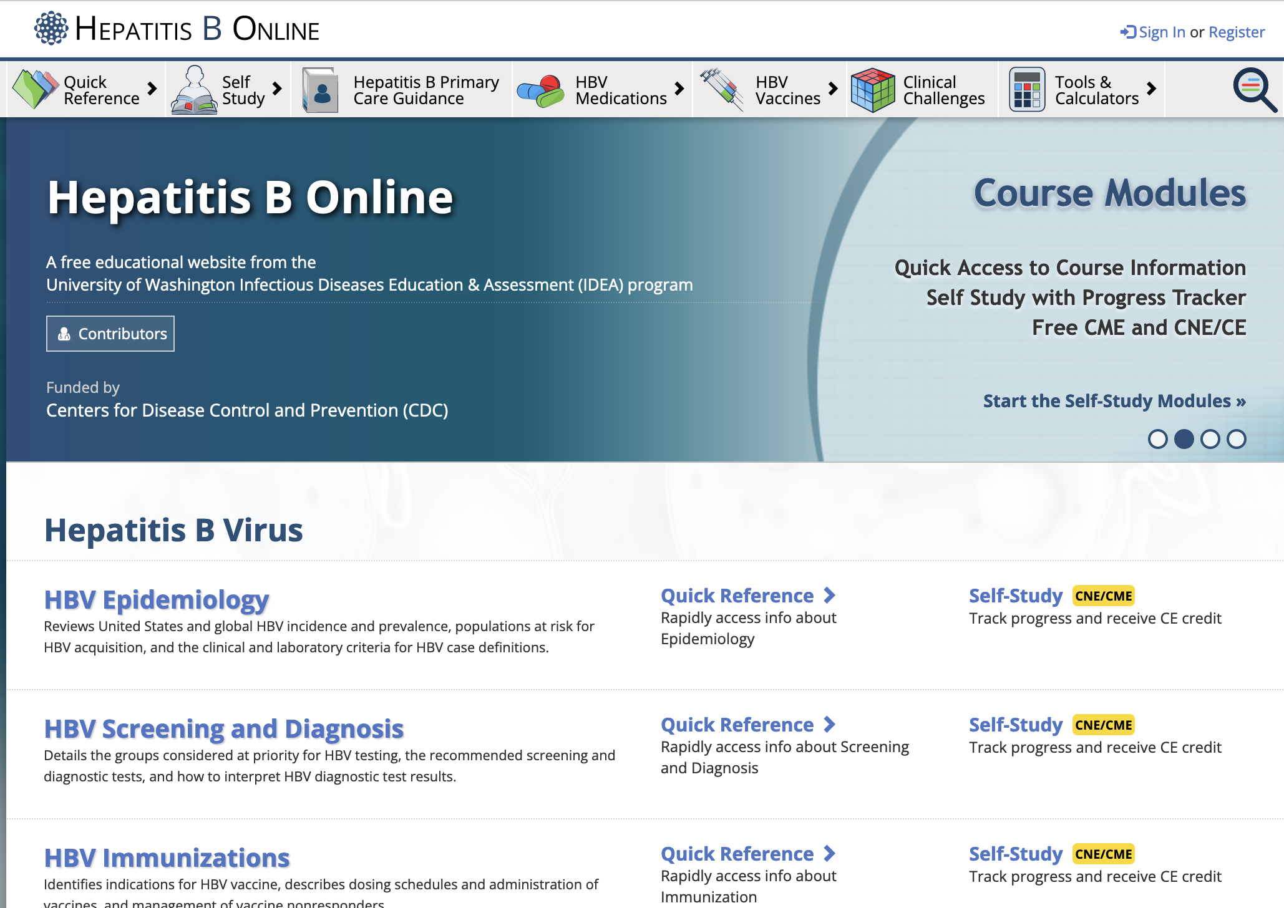
www.hepatitisb.uw.edu
Notes:
To learn about hepatitis B, please check out our Hepatitis B online curriculum which contains a variety of lessons, cases & slides to reinforce your knowledge.
Thanks for joining me today.

