Slide 1
Hepatitis B (HBV) Reactivation
Prepared by:
H. Nina Kim, MD MSc
Associate Editor, Hepatitis B and Hepatitis C Online
Professor of Medicine
Division of Allergy & Infectious Diseases
University of Washington
Last Updated: July 19, 2024
Notes:
Hello! This is Dr Nina Kim from the University of Washington. Today I will be discussing Hepatitis B Reactivation.

Slide 2
Disclosures
No disclosures
Notes:
Disclosure
Script out
Slide 6
Rituximab slide
Slide 21 - antiviral

Slide 3
HBV Reactivation
Why?
What happens?
Who is at risk?
Antiviral prophylaxis
Case example
Notes:
In this mini lecture, I will review
Why this clinical event is important to know and avoid. And touch on HBV virology & pathogenesis in understanding this.
What happens as HBV reactivation unfolds
Who is at risk? What factors – in the host as well as in the clinical scenario… contribute to Risk
I will talk briefly on antiviral prophylaxis
Finally: we will tie these concepts together in a case example

Slide 4
Why? And why now?

Slide 5
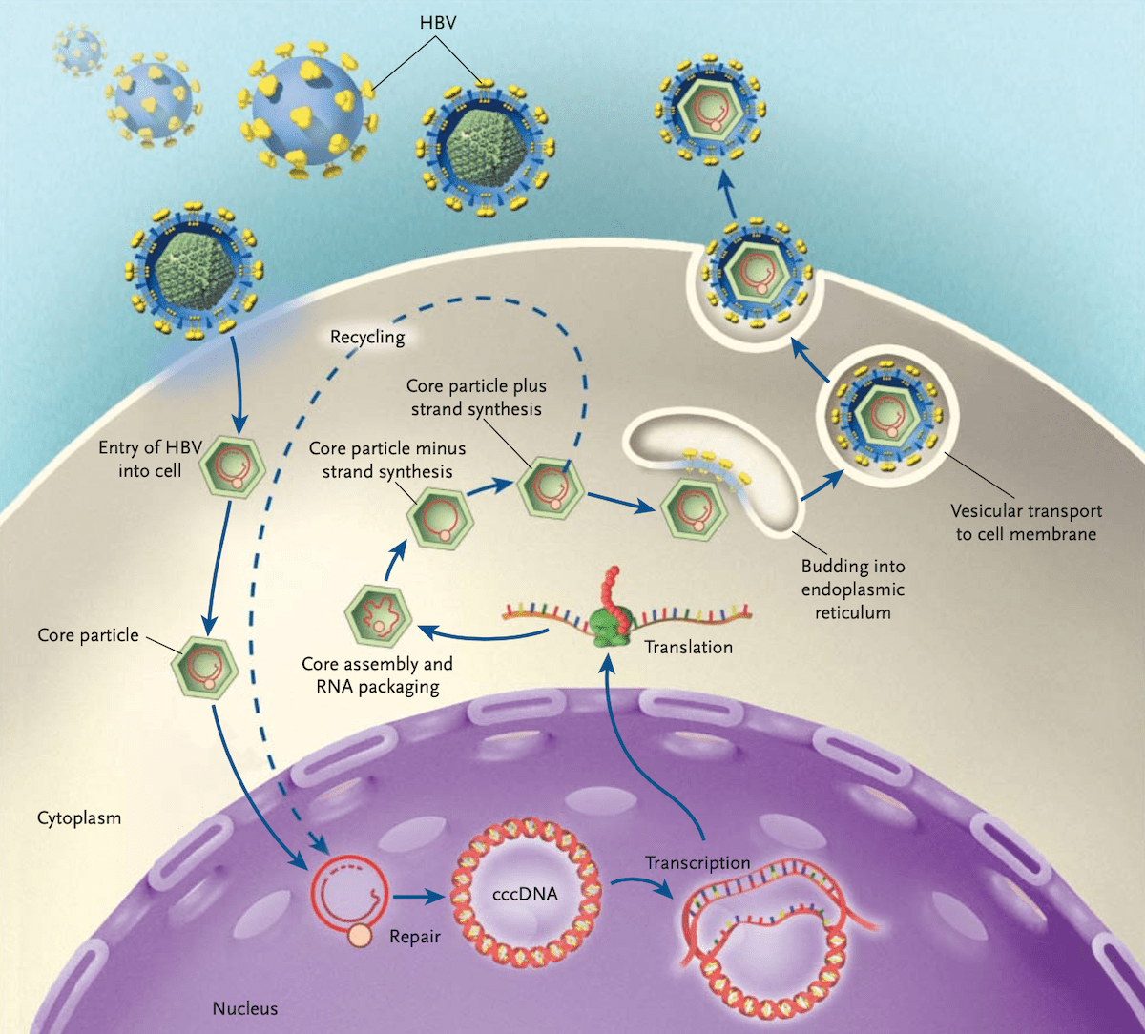
Ganem, N Engl J Med. 2004;350:1118-29.
Notes:
At the heart of this matter is the persistent nature of hepatitis B infection. In this depiction of the viral lifecycle, you can see that the virus – upon entering the liver cell and eventually the nucleus, integrates itself into the host genome. And in doing so, the virus establishes itself, through covalently closed circular DNA as a template for viral expression. In other words, an individual who has been exposed to the virus remains at risk, even after resolution of acute infection, of having recurrent expression of the virus with the loss of immune control.

Slide 6
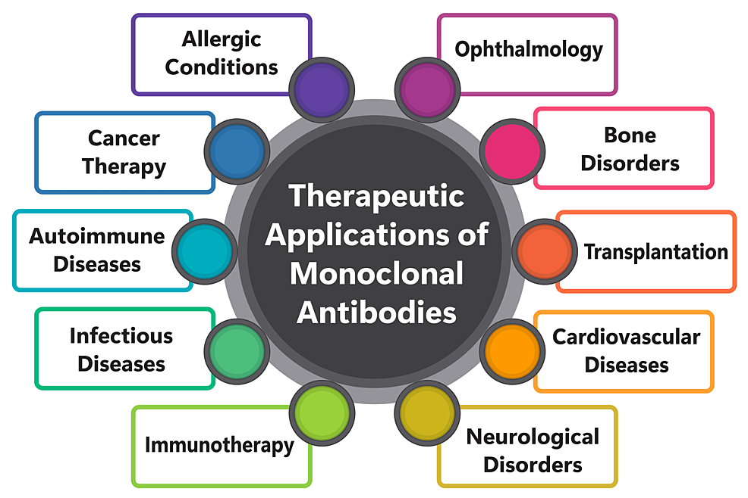
Kothari et al, Cureus 2024;16: e61983. doi:10.7759/cureus.61983
Notes:
And why HBV reactivation remains even more relevant today is because of the growing array of biologic agents – specifically: monoclonoal antibodies targeting various aspects of our immune system. Some of which have been shown to increase the risk of HBV reactivation.

Slide 7
HBV reactivation – what happens?
Notes:
So what happens in HBV reactivation? For this portion of the talk,
I will be referring to hepatitis B serologic markers – to familiarize yourself with these, please review the mini lecture on this topic on our Hep B online site or our YouTube channel.

Slide 8
HBV Reactivation - defined
Chronic HBV: HBsAg-positive and anti-HBc-positive:
  HBV DNA level increases ≥100-fold above baseline level;
  HBV DNA level of ≥1,000 IU/mL from a previously undetectable level; or
  HBV DNA level of ≥10,000 IU/mL if the baseline level is not available.
Resolved HBV: HBsAg-negative and anti-HBc-positive:
  Detectable HBV DNA, or
  Reversal of HBsAg seroconversion (reappearance of HBsAg).
Hepatitis flare:
  Alanine aminotransferase (ALT) increase of ≥ 3-fold baseline and >100 U/L.
Terrault et al, AASLD Hep B Guidance, Hepatol. 2018;67:1560-99.
Notes:
HBV reactivation occurs primarily in two main groups of individuals.
Those with chronic hepatitis B infection (who are surface antigen as well as core antibody positive). In these individuals, a 2 log or 100-fold rise in HBV viral level above baseline. OR a viral level that rises 1000 IU/mL or greater from previously undetectable level OR a HBV viral level of 10,000 IU/mL in someone without prior testing counts as HBV reactivation.
The second group are those who have previously been infected and recovered – they are generally surface Ag negative but core Ab positive.
In these individuals, any detectable HBV DNA or the reappearance of surface antigen is enough to count as HBV reactivation.
These viral changes are generally accompanied by a hepatitis flare which is defined as…

Slide 9
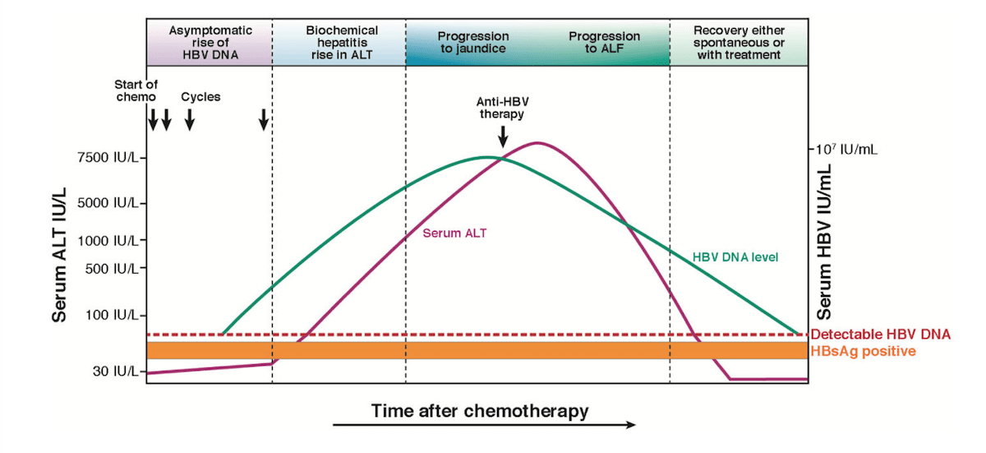
Loomba & Liang, Gastroenterol. 2017;152:1297-1309.
Notes:
First event in HBV reactivation is the rise in HBV DNA level (shown here in green). Followed by evidence of liver inflammation or a rise in serum ALT level in magenta.
You can see that the rise in liver enzymes can be brisk and severe with ALT that can exceed 5000 IU/L…
These changes can progress to jaundice and acute liver injury or further to liver failure

Slide 10
HBV Reactivation: Significant morbidity
HBV reactivation can result in acute liver failure, defined as any of the following:
  Impaired synthetic function: Total bilirubin >3 mg /dL or INR >1.5
  Ascites
  Encephalopathy
  Death following above
Terrault et al, AASLD Hep B Guidance, Hepatol. 2018;67:1560-99.
Notes:
And this is why it is important for everyone to recognize HBV reactivation.
Because at its worst, it can result in significant morbidity when it progresses to acute liver failure… and it can be fatal if not recognized promptly.

Slide 11
Who is at risk for HBV reactivation?

Slide 12
Who is at risk?
Persons with chronic hepatitis B (+HBsAg, +anti-HBc) or resolved HBV infection (-HBsAg, +anti-HBc) who are undergoing:
Chemotherapy
Treatment for autoimmune diseases
Solid organ or bone marrow transplantation
Direct-acting antiviral therapy for hepatitis C coinfection
HCC therapy
Immune checkpoint inhibition
Withdrawal of HBV antiviral therapy
Notes:
So there are a variety of clinical scenarios where HBV reactivation can occur.
The first three settings… involve immunosuppression of some kind. And these are the more common scenarios that I will be addressing today.
HCC Tx: antiviral therapy is recommended for all HBsAg-positive patients with HCC, the lack of prior diagnosis of HBV infection means that many patients may not be receiving antiviral treatment at the time of HCC diagnosis or treatment.
(Reference: https://aasldpubs.onlinelibrary.wiley.com/doi/full/10.1002/hep.32241?casa_token=sTFmMf77RsAAAAAA%3A5LRbtqpS4xUN9QmewpoH-sF_XH35LZrMuW1TjXzf_QAGkk-zHkgS_8pV_359gbpxFmQWpDSr-uOBODr8)

Slide 13
Who is at risk?
Persons with chronic hepatitis B (+HBsAg, +anti-HBc) or resolved HBV infection (-HBsAg, +anti-HBc) who are undergoing:
Chemotherapy
Treatment for autoimmune diseases
Solid organ or bone marrow transplantation
Direct-acting antiviral therapy for hepatitis C coinfection
HCC therapy
Immune checkpoint inhibition
Withdrawal of HBV antiviral therapy
Notes:
The last four are special circumstances where HBV can reactivate that I will not be addressing in my talk. But these are worth noting.

Slide 14
Risk Stratification by Therapy
High risk → HBV reactivation ≥10%
Moderate risk → HBV reactivation 1-10%
Low risk → HBV reactivation <1%
Notes:
So, the first step in considering an individual’s risk of HBV reactivation involves evaluating their HBV status, but also their intended immunosuppressive therapy.
And when we consider these therapies, we can group them as low, moderate and high risk for HBV reactivation with probabilities as shown here.

Slide 15
Therapies with High HBV Reactivation Risk
B-cell depleting monoclonal antibodies (anti-CD20)
  Rituximab, ofatumumab, ocrelizumab
Anthracycline derivatives
  Doxorubicin, epirubicin
Chronic or high-dose steroids
  ≥4 weeks, >20 mg prednisone
Tumor necrosis factor alpha (TNF-𝛼) inhibitors (more potent)
  Infliximab, adalimumab, certolizumab
Perrillo et al, AGA Technical Review, Gastroenterol. 2015;148:221-224.
Notes:
Therapies with the highest risk for HBV reactivation include
B cell depleting monoclonal antibodies that target CD20 receptor of the B lymphocyte… used for treatment of lymphoma or autoimmune conditions such as multiple sclerosis
Anthracycline derivatives – a class of chemotherapy that includes __
Chronic or high-dose steroids – typically those that are on the order of 20 mg prednisone or more daily for a month or more.
TNF alpha

Slide 16
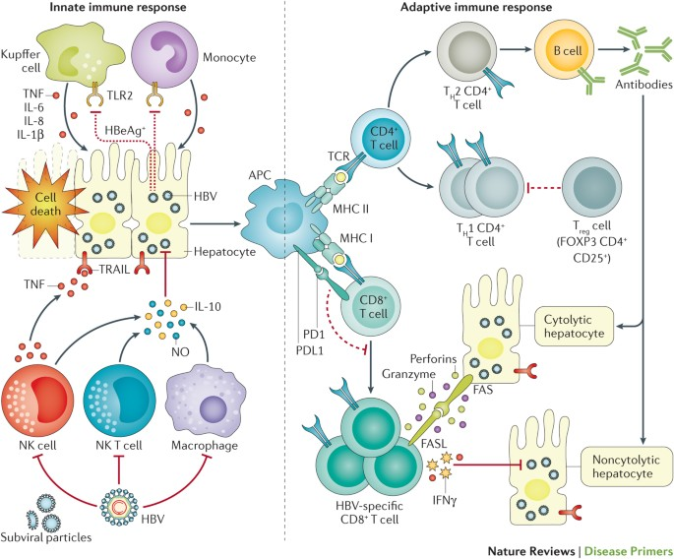
Rituximab: Highest Risk of HBV Reactivation
Yuen et al, Nat Rev Dis Primers. 2018;4. https://doi.org/10.1038/nrdp.2018.35
Notes:
Of these, rituximab deserves special mention. This and similar agents carry a particularly high risk of HBV reactivation…in both patients who have chronic infection as well as those who have resolved their infection. It was through increasing reports of HBV reactivation with these agents that we learned the key role B cells have in control of HBV infection.
The risk of HBV reactivation is serious enough to warrant a black box warning for this complication. And anyone who uses these medications needs to be aware of this risk.

Slide 17
Therapies with Moderate HBV Reactivation Risk
Systemic chemo (not mentioned previously)
Less potent TNF-𝛼 inhibitors
Cytokine or integrin inhibitors (abatacept, ustekinumab, natalizumab…)
Histone deacetylase inhibitors (HDIs)
Tyrosine kinase inhibitors (imatinib, nilotinib)
Immunophilin inhibitors (cyclosporine, tacrolimus)
Low-dose steroids (<10 mg prednisone) in HBsAg(+)
Medium-dose steroids (10-20 mg prednisone) in anti-HBc(+), HBsAg(-)
Perrillo et al, AGA Technical Review, Gastroenterol. 2015;148:221-224.
Notes:
Therapies with moderate risk for HBV reactivation include a variety of different agents including
Other systemic chemo
Less potent TNF alpha inhibitors
TK inhibitors
And steroids that are low dose in patients who have chronic HBV
Medium dose for those who have resolved infection.

Slide 18
Therapies with Low HBV Reactivation Risk
Anti-metabolites: Methotrexate
Azathioprine
6-mercaptopurine
Prednisone <10 mg daily
Intra-articular steroids
Perrillo et al, AGA Technical Review, Gastroenterol. 2015;148:221-224.
Notes:
This list are the agents that are associated with low risk of HBV reactivation…
So, how does one keep track of these therapies? You don’t need to – because you can always consult these categories again.

Slide 19
Therapies with High HBV Reactivation Risk
B-cell depleting monoclonal antibodies (anti-CD20)
  Rituximab, ofatumumab, ocrelizumab
Anthracycline derivatives
  Doxorubicin, epirubicin
Chronic or high-dose steroids
  ≥4 weeks, >20 mg prednisone
Tumor necrosis factor alpha (TNF-𝛼) inhibitors (more potent)
  Infliximab, adalimumab, certolizumab
Perrillo et al, AGA Technical Review, Gastroenterol. 2015;148:221-224.
Notes:
But it is important to know this list by heart, esp if you use these medications with any regularity.

Slide 20
Who should receive antiviral prophylaxis?

Slide 21
HBV Reactivation: Treat or Monitor?
HBV Status | High risk | Moderate risk | Low risk
Chronic HBV: HBsAg(+), anti-HBc(+) | If criteria for treatment met (independent of reactivation risk), then treat
 | Treat* | Treat** | Monitor**
Resolved HBV: Anti-HBc(+), HBsAg(-) | Treat* | Monitor or Treat** | Monitor**
*(Strong recommendation, Moderate-quality evidence); **(Weak recommendation, Moderate-quality evidence)
Reddy et al, AGA Guideline on Prevention & Treatment of HBV Reactivation, Gastroenterol. 2015;148:215-9.
Notes:
This table provides the general guidance on the decision to start antiviral therapy or monitor. Taking the HBV status as well as the risk level of the therapy into account.
It is worth noting that the American Gastroenterology Association emphasizes that if the patient with chronic HBV meets clinical criteria to start antiviral therapy based on their disease status (for example, the patient has cirrhosis or persistently elevated liver enzymes and HBV DNA level) then treatment should start for their hepatitis B regardless of the risk level of the intended immunosuppressive therapy.

Slide 22
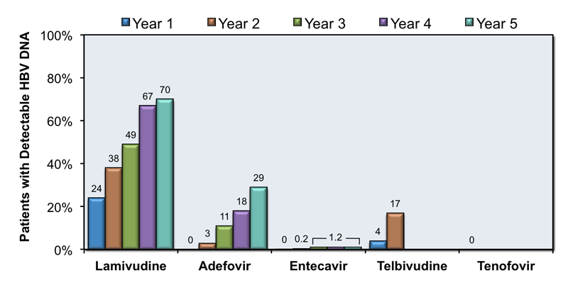
Antiviral therapy for prevention of HBV reactivation
Tenofovir DF, tenofovir AF or entecavir
NOT lamivudine
At least 6 months after discontinuation of immunosuppressive therapy or
At least 12 months after discontinuation of B-cell depleting therapy
Reddy et al, AGA Guideline on Prevention & Treatment of HBV Reactivation, Gastroenterol. 2015;148:215-9.
Notes:
What we use for prophylactic antiviral therapy is the same as what use for oral treatment of hepatitis B, and that is tenofovir (as either formulation) or entecavir.
Lamivudine is not recommended for much of the same reason it is not recommended for treatment – since the threshold for viral resistance and breakthrough is low.
And duration is generally for the time that patient is undergoing immunosuppressive therapy out to at least 6 months after therapy has ended – extended out to at least 12 months (I generally err on 18 months) after B cell depleting therapy

Slide 23
Case example
Notes:
So let’s run through a case

Slide 24
Case
50 year-old woman with a longstanding history of multiple sclerosis with gait instability has a recent diagnosis of optic neuritis. Her neurologist is considering ocrelizumab. She has hypertension, type 2 diabetes and no obvious HBV risk factors.
Which of the following would you do next?
  Start ocrelizumab with quarterly hepatic function panel testing.
  Send hepatitis B surface antigen (HBsAg).
  Send hepatitis B core antibody (anti-HBc).
  Assess HBV status with triple-test panel (HBsAg, anti-HBc, anti-HBs).

Slide 25
Case
50 year-old woman with a longstanding history of multiple sclerosis with gait instability has a recent diagnosis of optic neuritis. Her neurologist is considering ocrelizumab. She has hypertension, type 2 diabetes and no obvious HBV risk factors.
Which of the following would you do next?
  Start ocrelizumab with quarterly hepatic function panel testing.
  Send hepatitis B surface antigen (HBsAg).
  Send hepatitis B core antibody (anti-HBc).
  Assess HBV status with triple-test panel (HBsAg, anti-HBc, anti-HBs).
Notes:
The answer is D – that you would send the triple test panel that includes…
You need all three results to fully characterize a patient’s HBV status

Slide 26
Case
50 year-old woman with a longstanding history of multiple sclerosis with gait instability has a recent diagnosis of optic neuritis. Her neurologist is considering ocrelizumab. She has hypertension, type 2 diabetes and no obvious HBV risk factors. Her hep B panel shows: (+) anti-HBc, negative surface antigen and surface antibody.
Which of the following would you do next?
  Start ocrelizumab with quarterly hepatic function panel testing.
  Start entecavir 0.5 mg once daily for HBV prophylaxis.
  Start ocrelizumab and monitor for clinical symptoms.
  Send hepatitis B e antigen and e antibody.

Slide 27
Case
50 year-old woman with a longstanding history of multiple sclerosis with gait instability has a recent diagnosis of optic neuritis. Her neurologist is considering ocrelizumab. She has hypertension, type 2 diabetes and no obvious HBV risk factors. Her hep B panel shows: (+) anti-HBc, negative surface antigen and surface antibody.
Which of the following would you do next?
  Start ocrelizumab with quarterly hepatic function panel testing.
  Start entecavir 0.5 mg once daily for HBV prophylaxis.
  Start ocrelizumab and monitor for clinical symptoms.
  Send hepatitis B e antigen and e antibody.
Notes:
The answer is B: to TREAT

Slide 28
Therapies with High HBV Reactivation Risk
B-cell depleting monoclonal antibodies (anti-CD20)
  Rituximab, ofatumumab, ocrelizumab
Anthracycline derivatives
  Doxorubicin, epirubicin
Chronic or high-dose steroids (≥4 weeks, >20 mg prednisone)
  Chemo for lymphoma, leukemias or breast, lung or pancreatic cancer
Tumor necrosis factor alpha (TNF-𝛼) inhibitors (more potent)
  Infliximab, adalimumab, certolizumab
Perrillo et al, AGA Technical Review, Gastroenterol. 2015;148:221-224.
Notes:
And the reason we TREAT is because of ocrelizumab is a B-cell depleting monoclonal antibody with high risk of HBV reactivation.

Slide 29
HBV Reactivation: Treat or Monitor?
HBV Status | High risk | Moderate risk | Low risk
Chronic HBV: HBsAg(+), anti-HBc(+) | If criteria for treatment met (independent of reactivation risk), then treat
 | Treat* | Treat** | Monitor**
Resolved HBV: Anti-HBc(+), HBsAg(-) | Treat* | Monitor or Treat** | Monitor**
*(Strong recommendation, Moderate-quality evidence); **(Weak recommendation, Moderate-quality evidence)
Reddy et al, AGA Guideline on Prevention & Treatment of HBV Reactivation, Gastroenterol. 2015;148:215-9.
Notes:
So that regardless of whether you are a chronic carrier or someone who core Ab+ but negative surface Ag, the recommendation is to TREAT

Slide 30
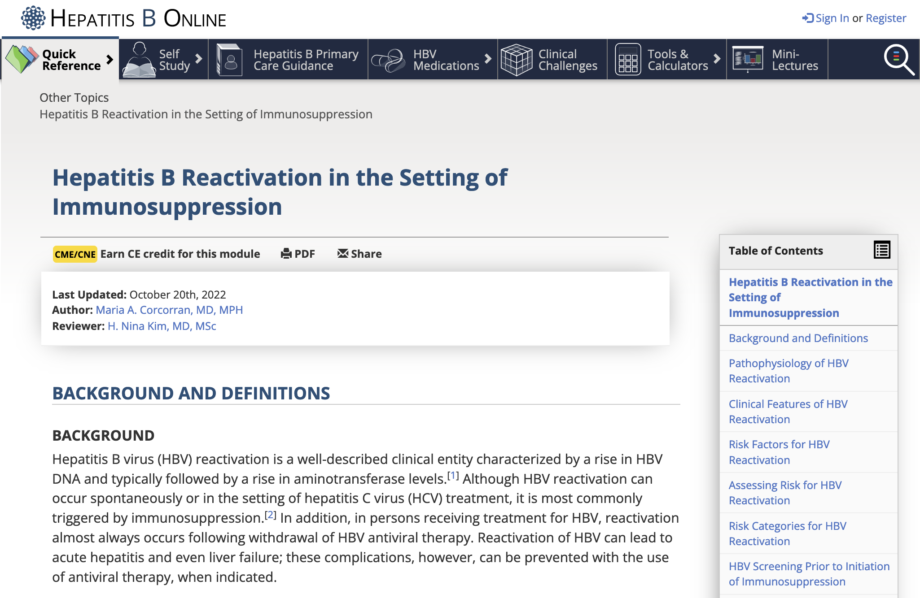
Notes:
For a deeper dive into hepatitis B reactivation, please check out our lesson on the Hep B Online site which reviews in greater detail the clinical decision-making and guidelines.
CLINTON: Can we add a QR code for this page? Defer to you on what you think might be best.

